Slide 1
The trump administration and Women’s Rights
Measures taken by the Trump administration that have impacts on women’s lives

Slide 2
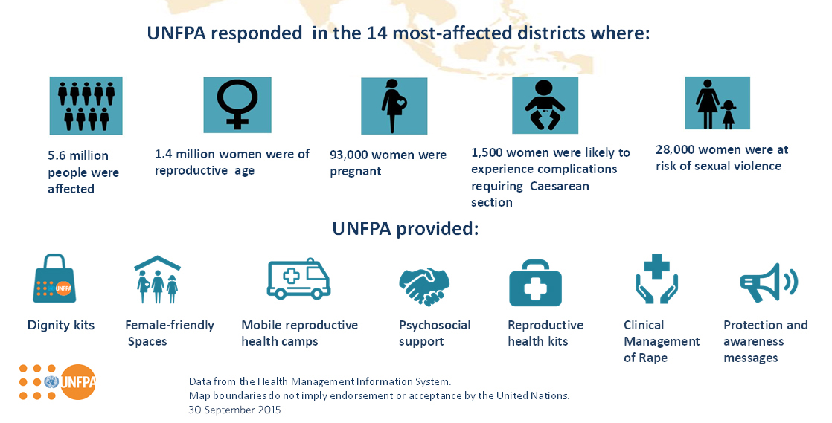
In the first 100 days of his presidency, Donald Trump cut international funding to NGOs advising abortion. For instance, funding for the UNFPA was cut in 2017,2018 and 2019
Examples of the UNFPA’s actions:
Access to contraception
Fight maternal mortality
Fight against FGM
Help with HIV/AIDS

Slide 3
The law required companies to communicate figures about the gender ratio in the work place > The Trump administration put an end to that obligation, thus weakening the monitoring of equal pay in private companies.

Slide 4
only 3 women out of 23 members. Only one woman filled a traditionally male position > Gina Haspel was the first female director of the CIA
President Trump’s cabinet:

Slide 5
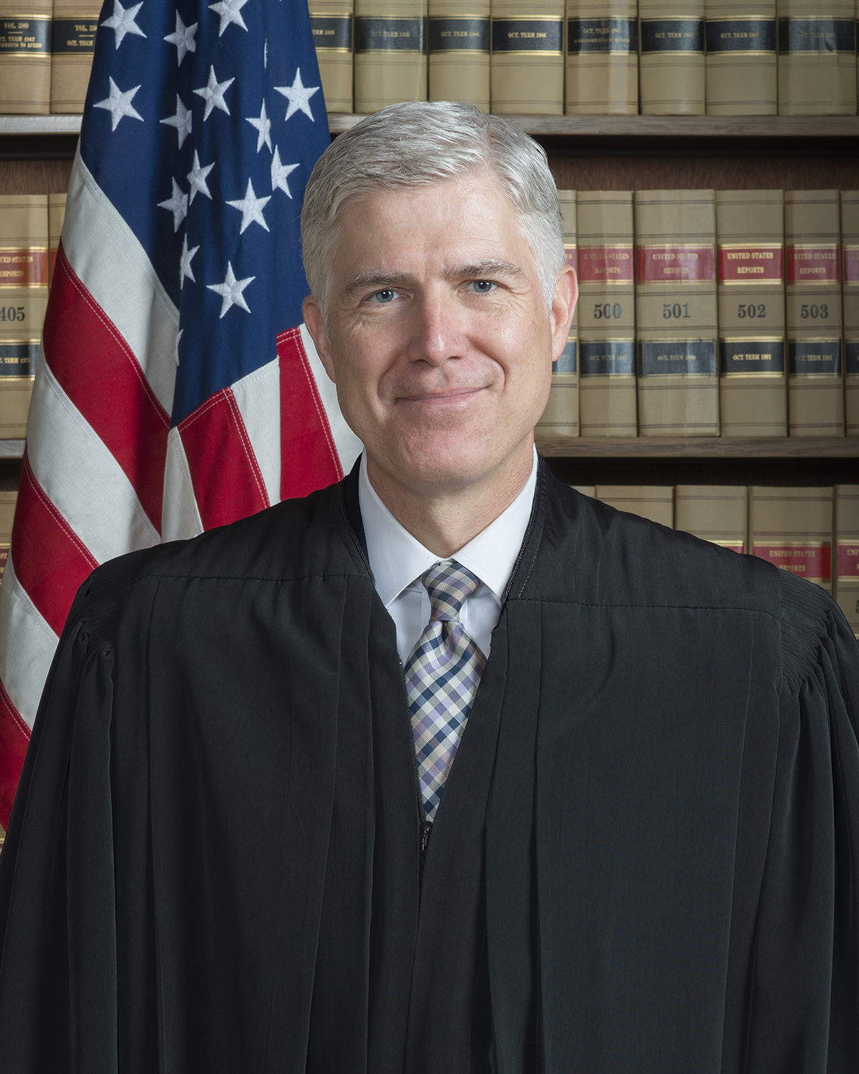
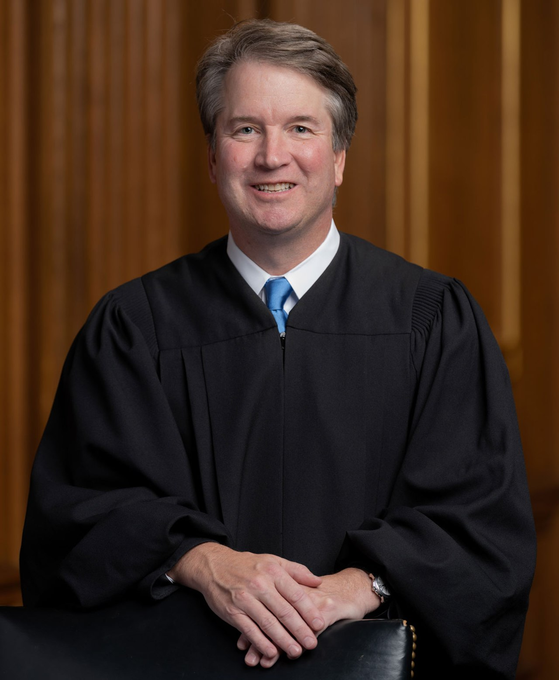
Donald Trump appointed three new Supreme Court Justices during his term of office. Three very conservative and ‘originalist’ justices who could potentially overturn Roe vs Wade
Neil Gorsuch – January 2017
Brett Kavanaugh – July 2018
Amy Coney Barrett – Oct 2020

Slide 6
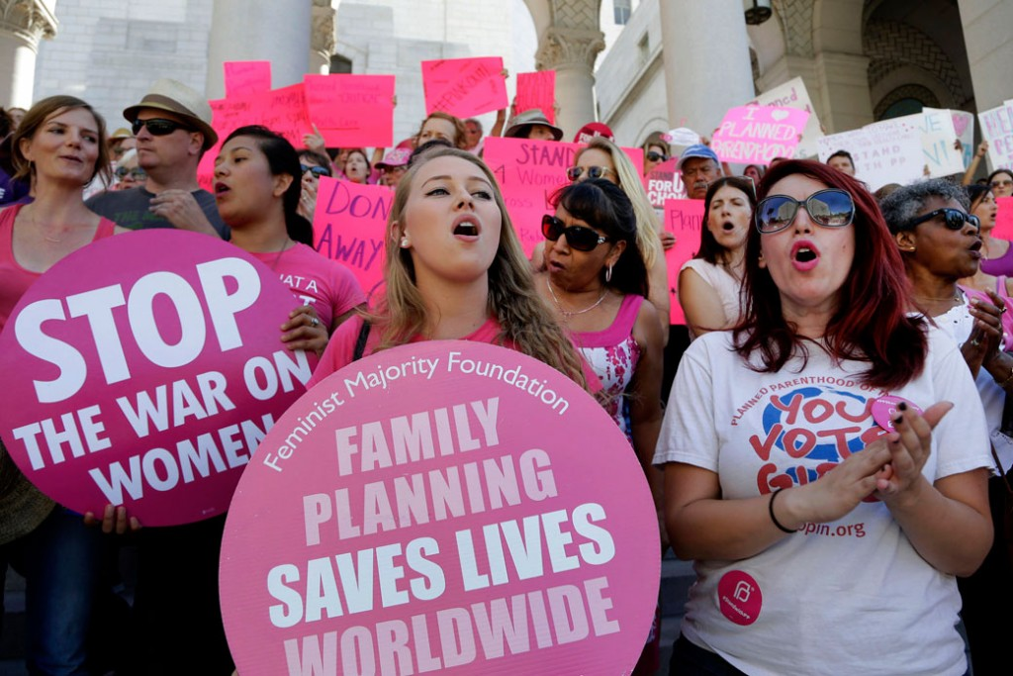
They blocked money allotted to Planned Parenthood

Slide 7
They threatened private abortion coverage, leaving women to pay for their own abortion.
Yet the number of abortions in the US has never been lower, proving the success of decades of birth control.

Slide 8
Yet they also undermined the Affordable Care Act’s birth control benefit

Slide 9
They finally limited an increase in the overtime earnings and protection owed to lower income workers (mainly women)

