Slide 1
Migration in Europe
Migration in Europe-let's share our differences and move on!

Slide 2
What is MIGRATION?
Migration is:
The process of going to another place or country, often in order to find work.
Seasonal movement of animals from one place to another.

Slide 3
?Reasons for Migration?
Push factors:
-Unemployment
-Poverte
-Famine
-Overpopulation
-Political Persecutions
-Anti-Semitism
Pull factors:
-Employment
-”streets paved with gold”
-Religious Freedom
-Political Freedom
-Steamboat Ads

Slide 4
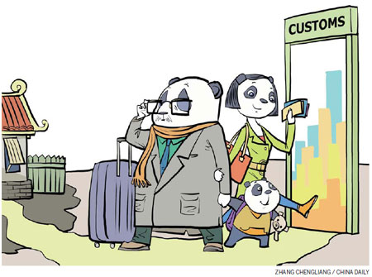
The pros of Migration..
-Services to an ageing population can be maintained when there are insufficient young people locally.
-The pension gap can be filled by the contributions of new young workers and they also pay taxes.
-Immigrants bring energy and innovation.
-Job vacancies and skills gaps can be filled.

Slide 5
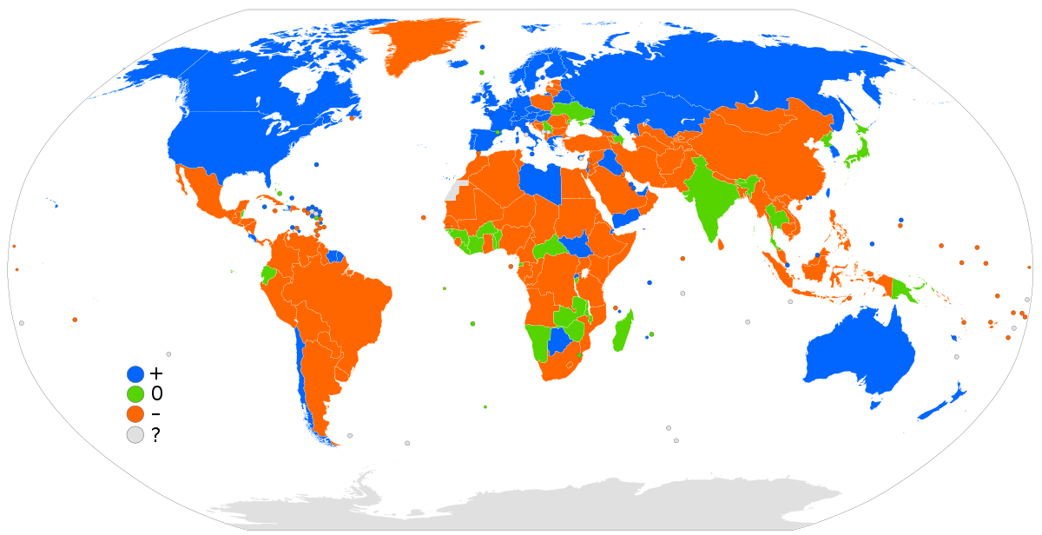
The cons of Migration?
-Having workers willing to work for relatively low pay may allow employers to ignore productivity, training and innovation.
-Migrants may be exploited.
-Unemployment may rise if there are unrestricted numbers of incomers
-Increases in population can put pressure on public services.

Slide 6
Is it popular Nowadays?
Of course, we can’t deny that migration it is real popular nowadays because of different reasons.
-Students migration in order to study, work or just travelling.
-Migrations in order to improve/change life.
-Migrations in order to find a work.

Slide 7
Thank you for your attention!
Made by Vasilii Atlarov
“G.S.Rakovski” Romance Language Secondary School
Bugas, Bulgaria

