Slide 1
OCDSB Maker Challenge #2
Submitted by Mme Phillips´ Grade 4/5 French Immersion Class Jockvale Elementary School

Slide 2
The Challenge:
Caring
What can you create to improve the wellbeing of others or your own?

Slide 3
The Migraine Reliever
Goal: To help people block noise and light, and practice relaxation techniques when suffering from a migraine attack.
Product: A device that will:
block sound
absorb and reflect light
Use a QR code to take migraine sufferers to a bilingual Google Site that teaches relaxation techniques

Slide 4
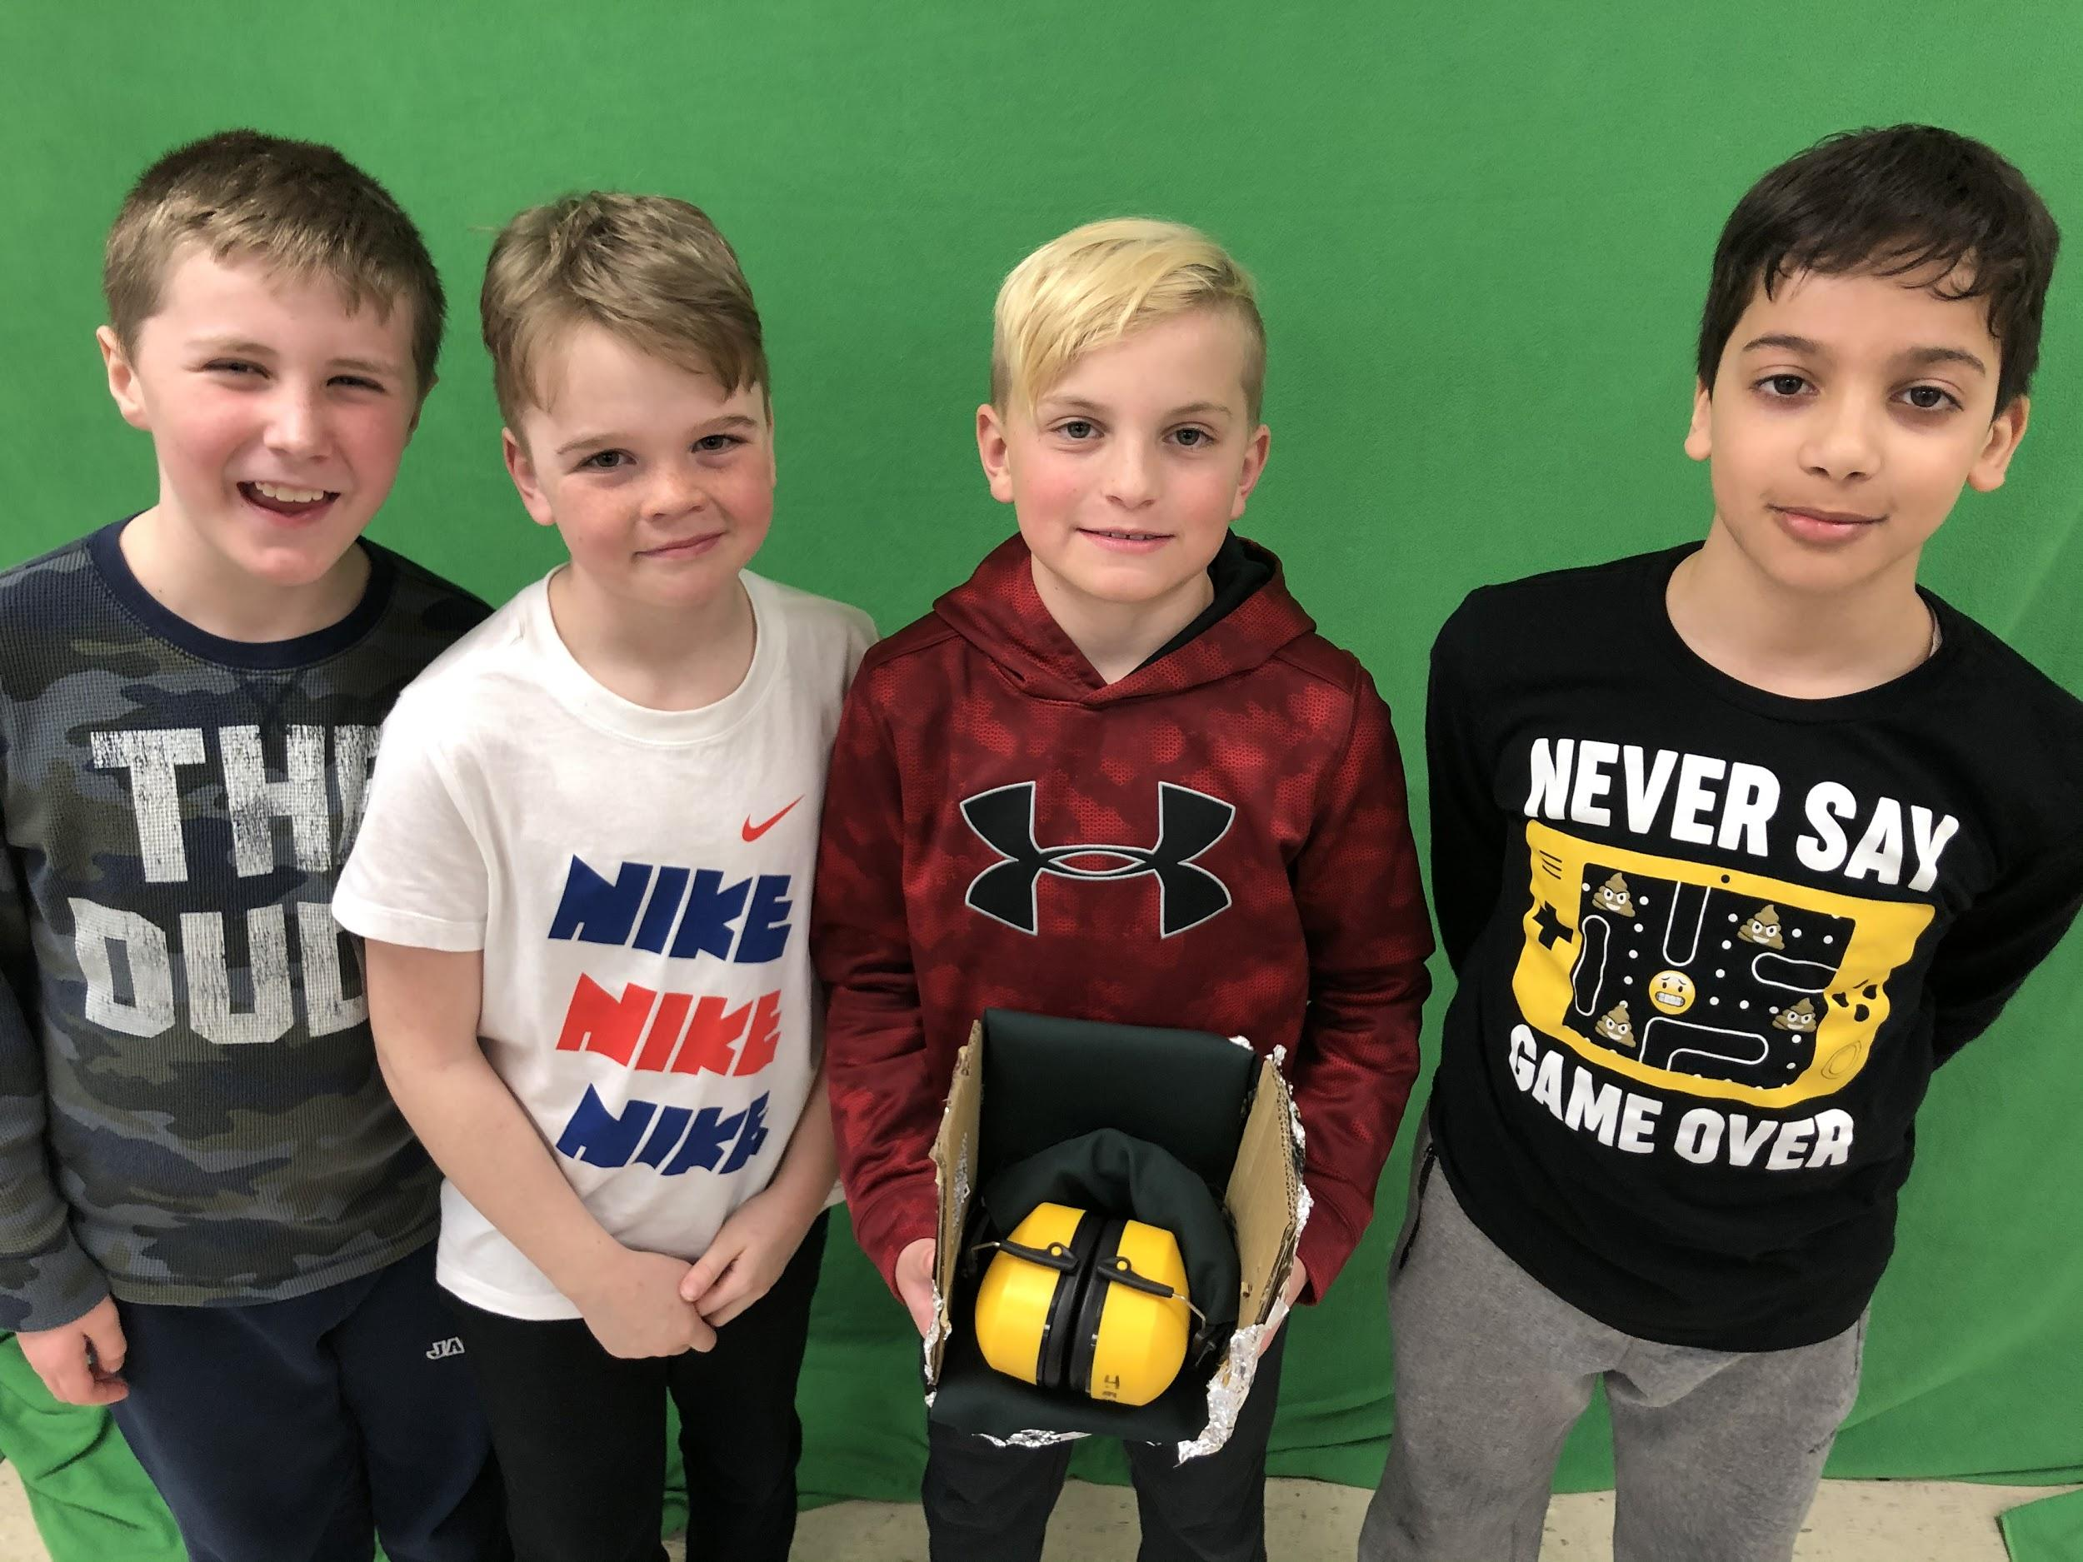
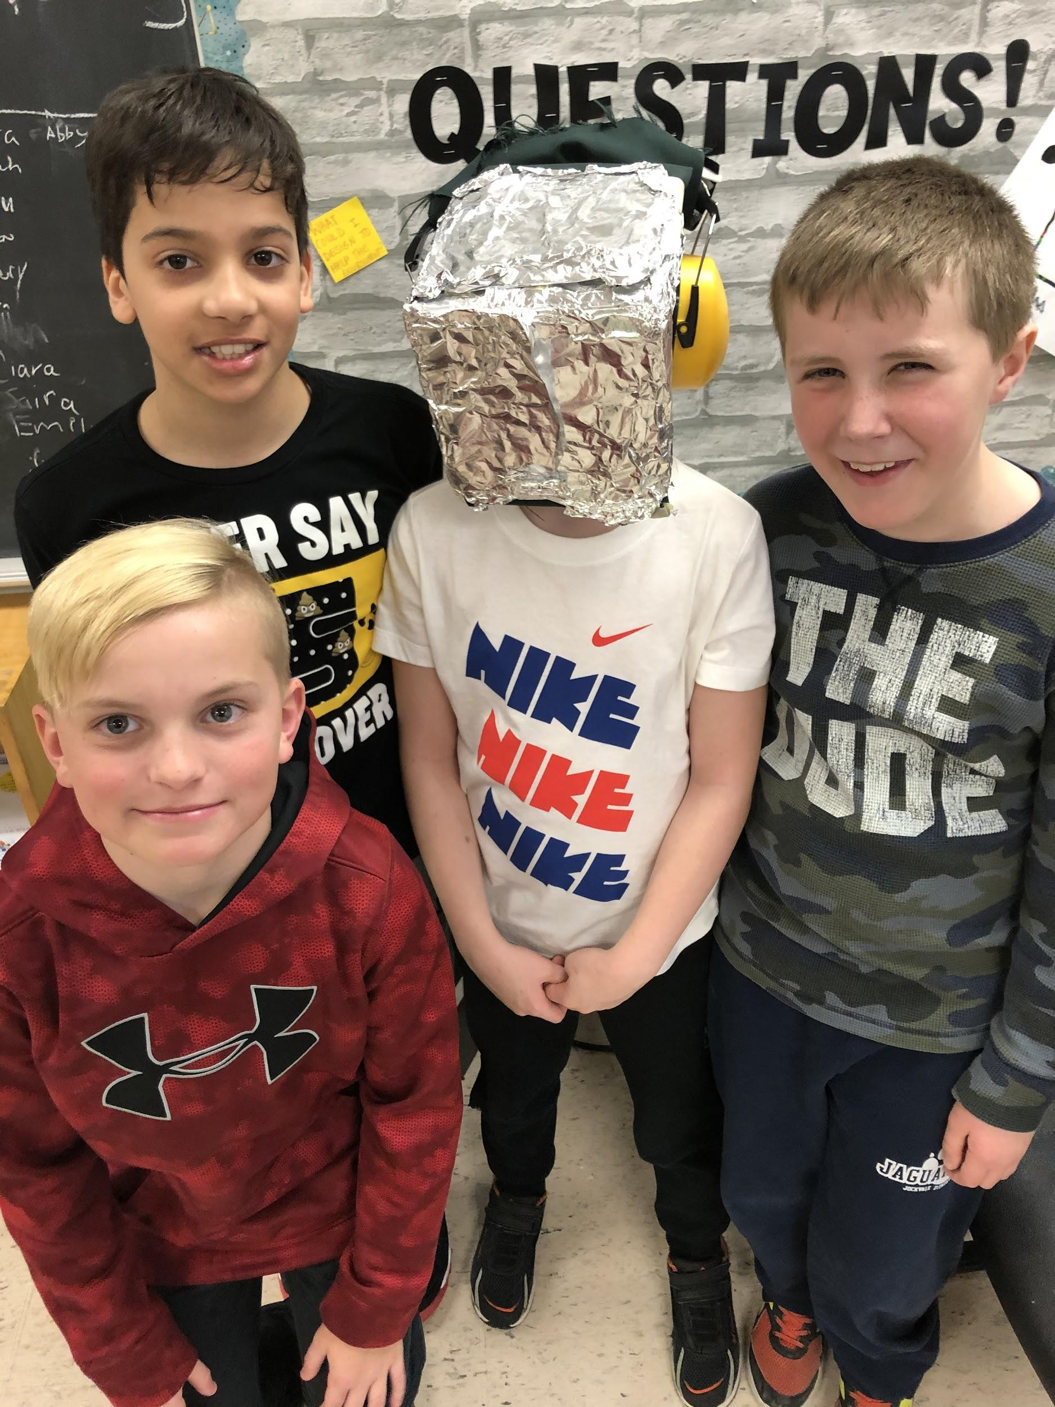
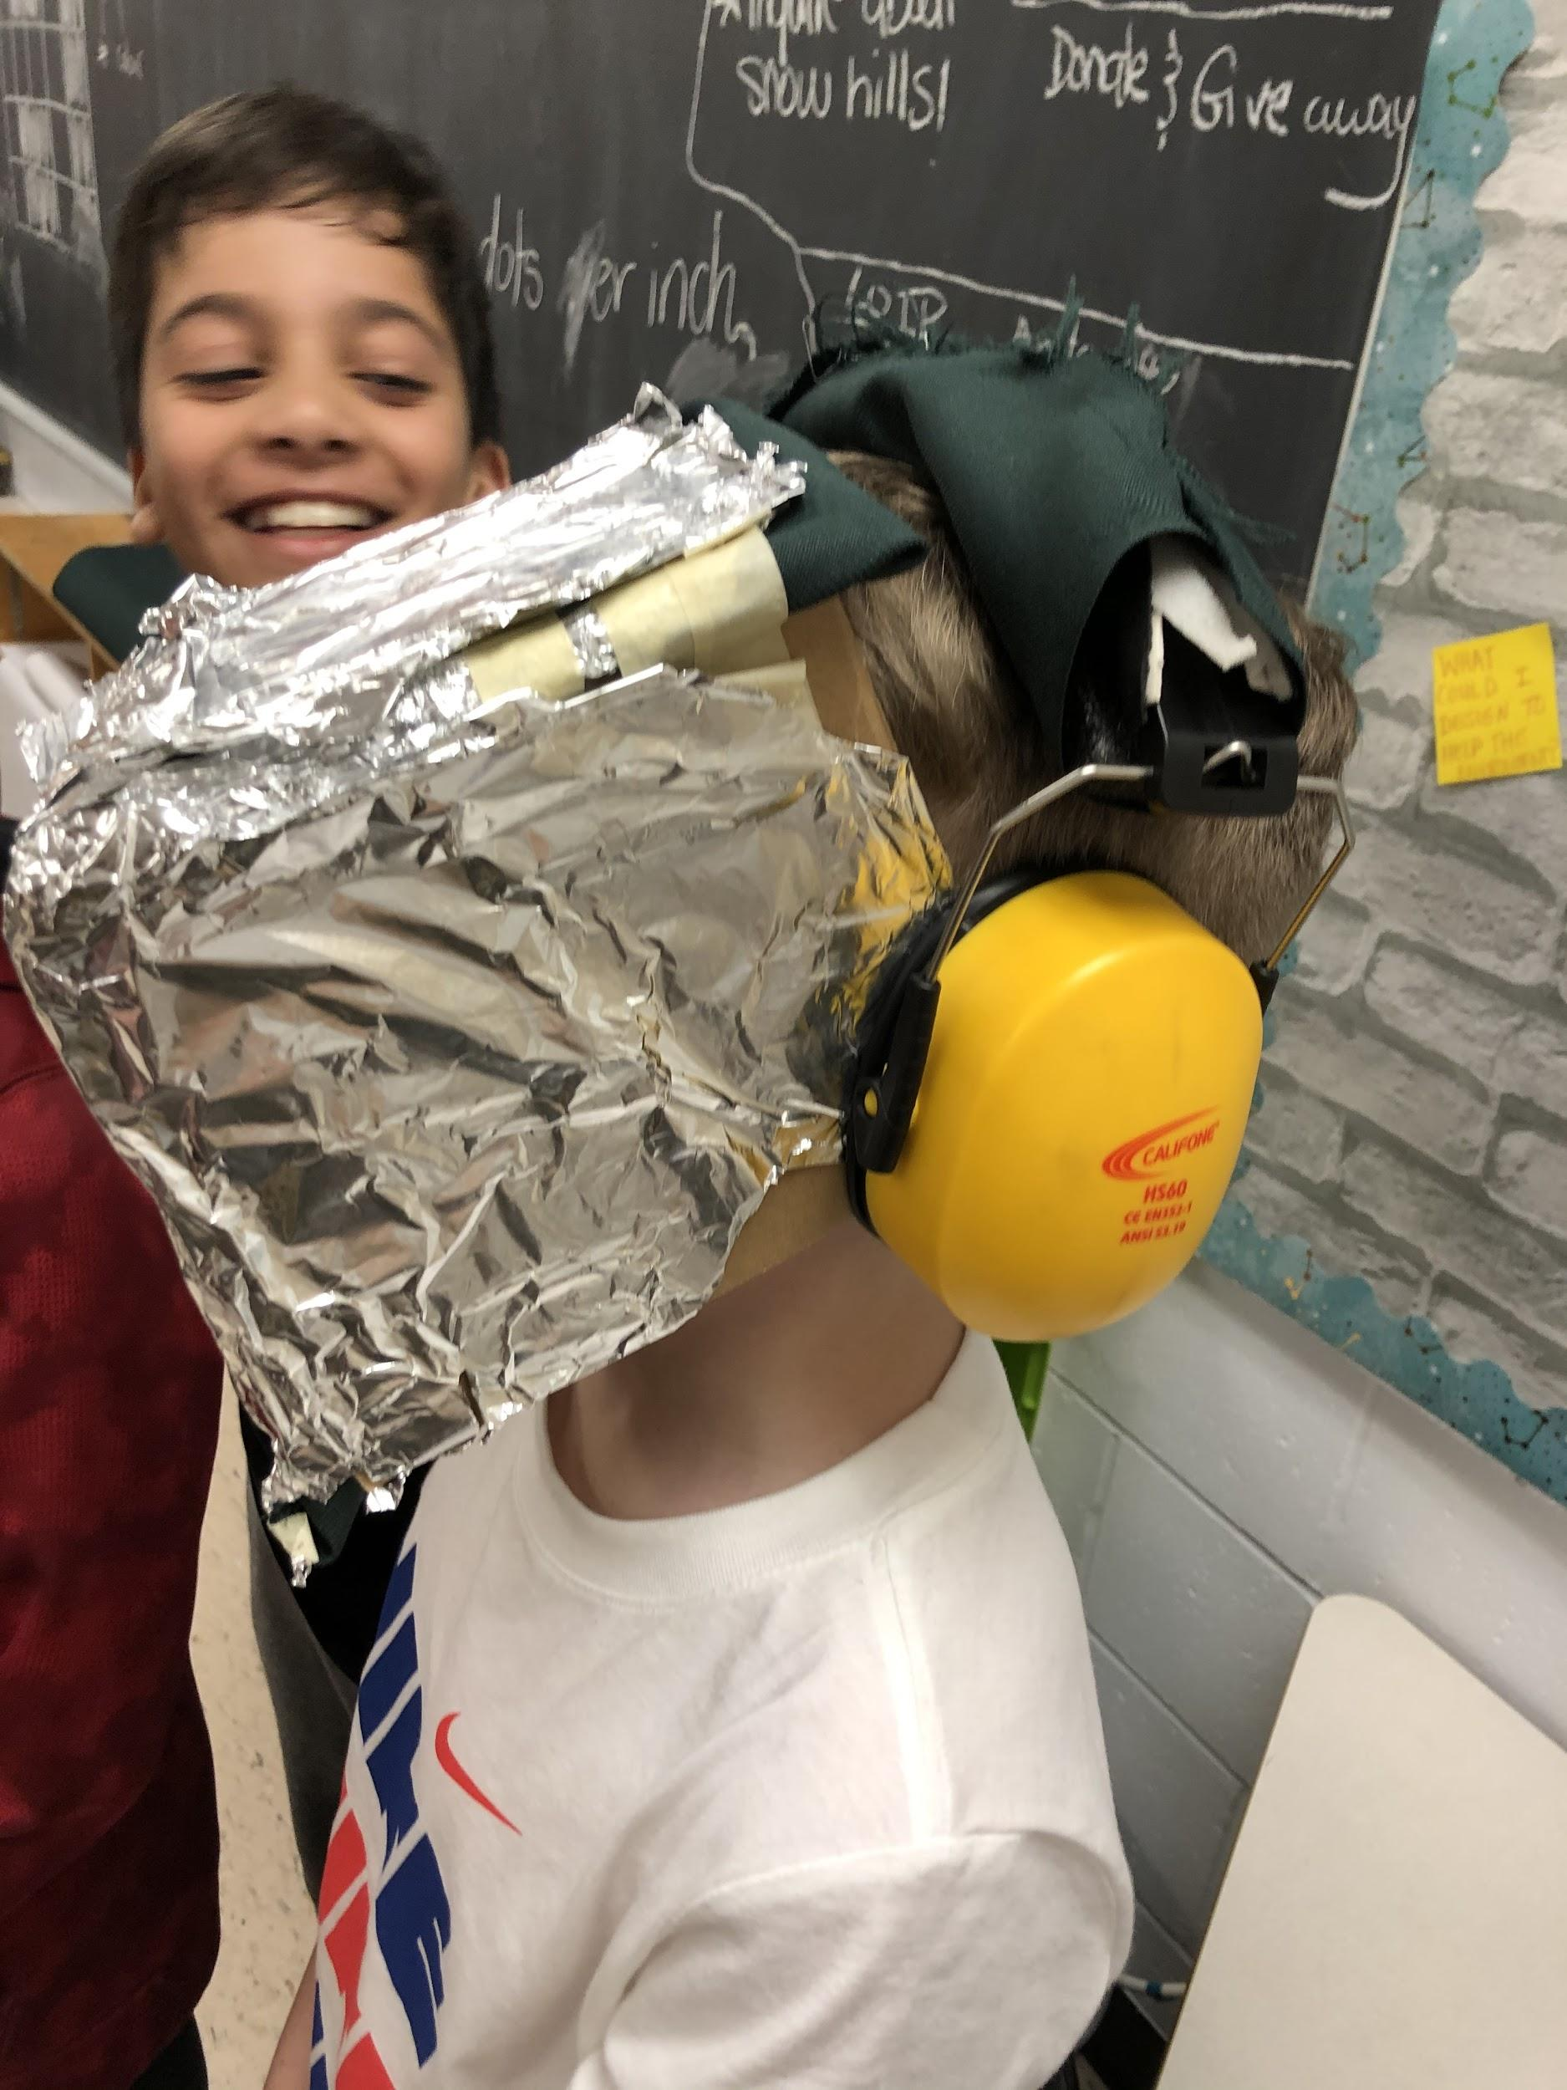
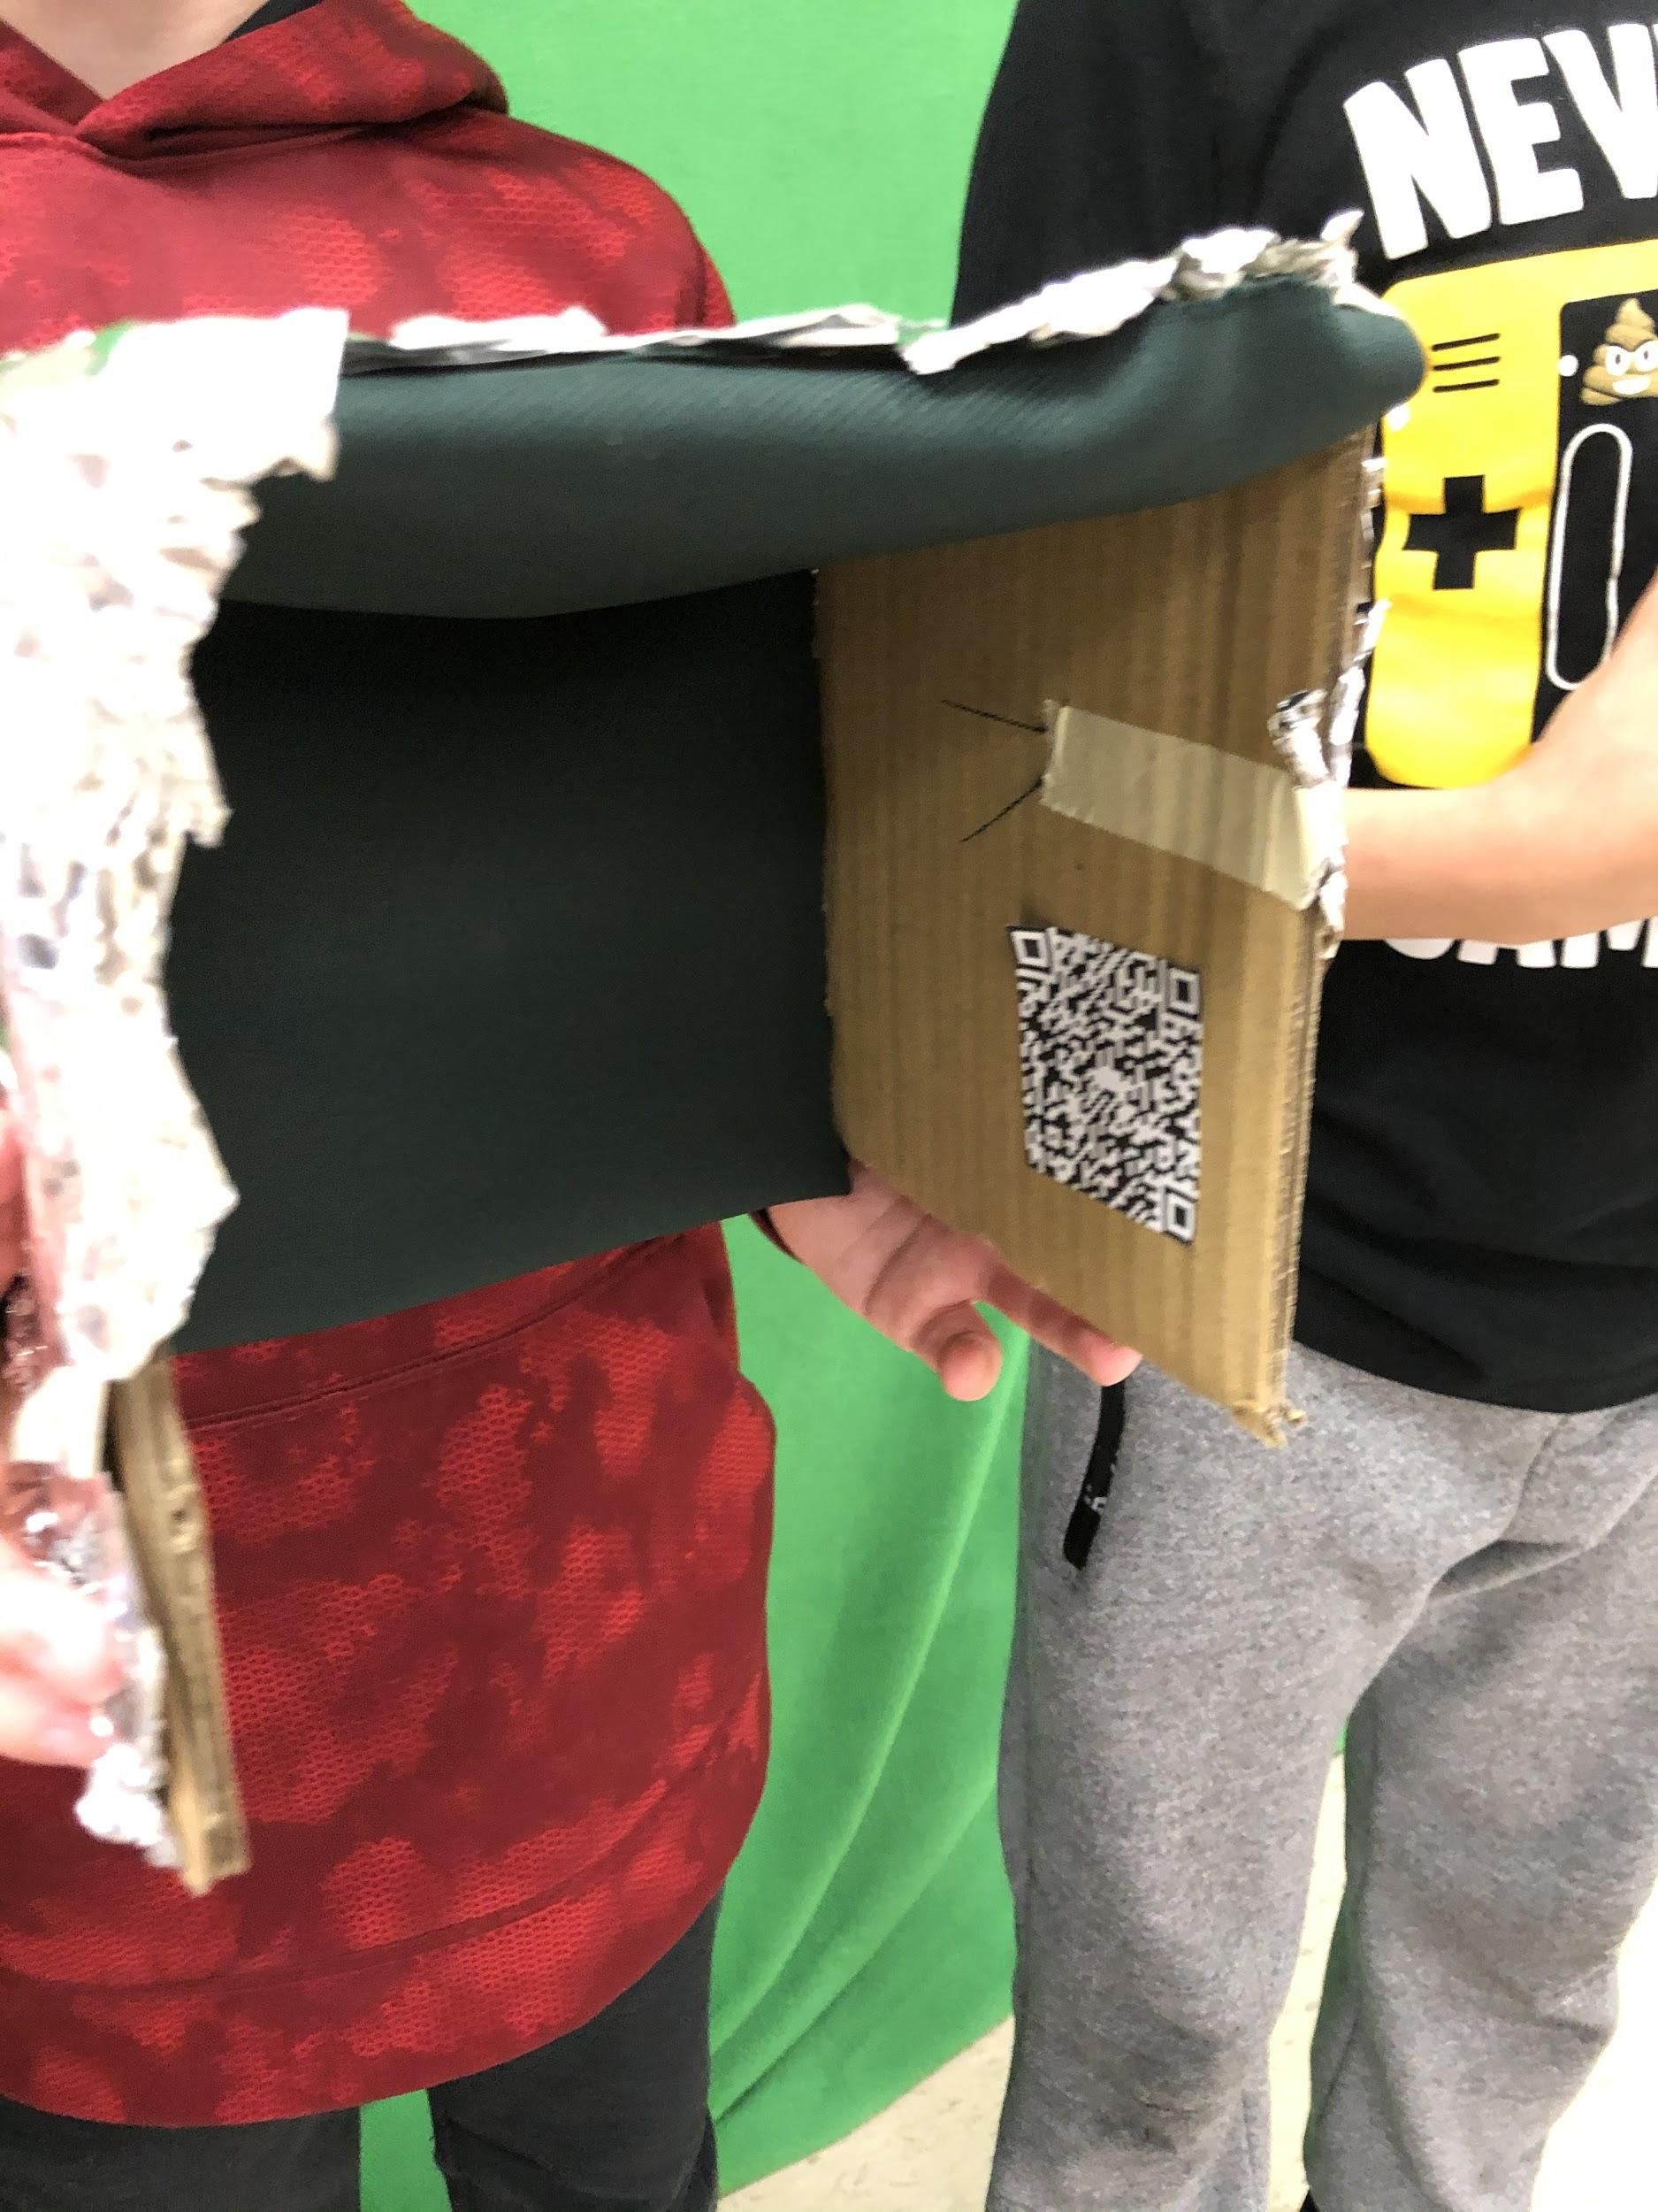
The Migraine Reliever
Web-site

Slide 5
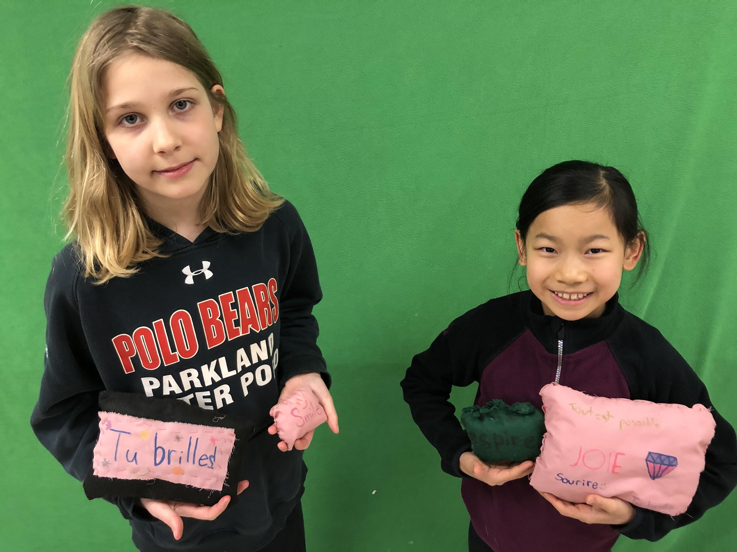
Inspirational Pillows
Goal: To help seniors living at the Longfield´s Manor feel good about themselves by using bilingual positive messages.
Product: Hand sewn pillows with inspirational messages (messages created using a combination of an electronic cutting machine and freehand printing with fabric markers).

Slide 6
Dollhouse and Dolls to promote relaxation and to remind children to use the WITS strategies
Goal: To help children at CHEO take their minds off of the negative situation and focus on the positive. When they return to school, the idea is that they will bring their doll with them. If anyone treats them unkindly because they look different (as a result of treatment) the doll will help them to remember to use the WITS strategies.
Products:
Hand sewn dolls with the WITS messages on the back
Cardboard dollhouse designed and constructed by the group members

Slide 7
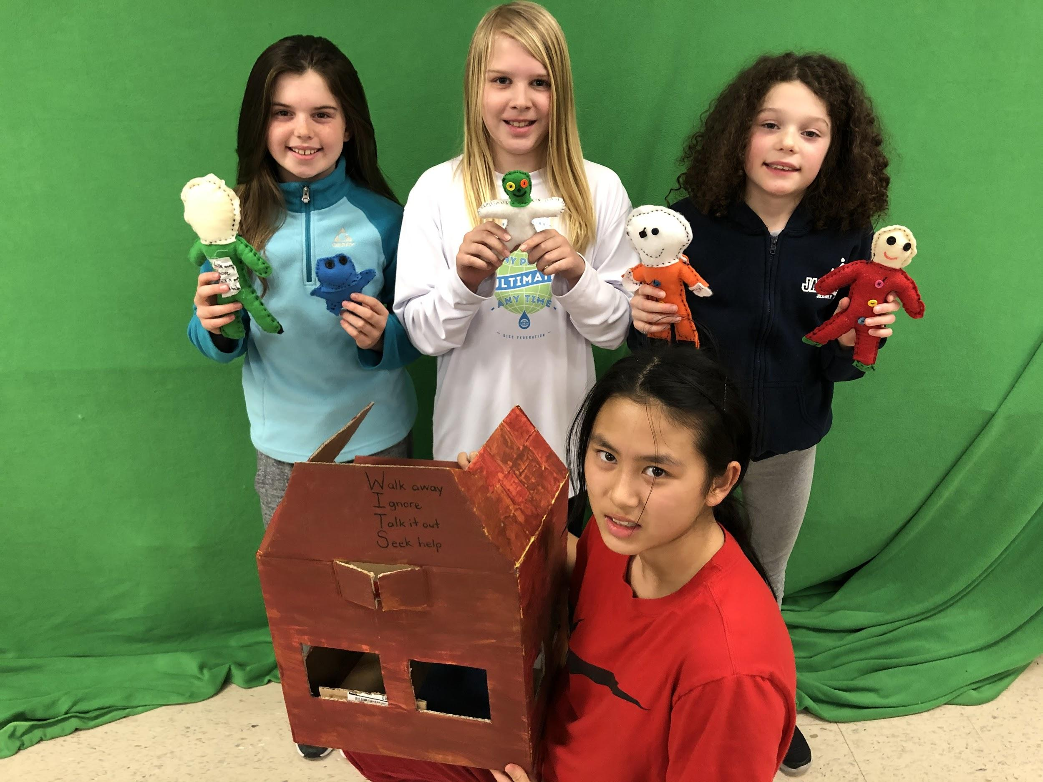
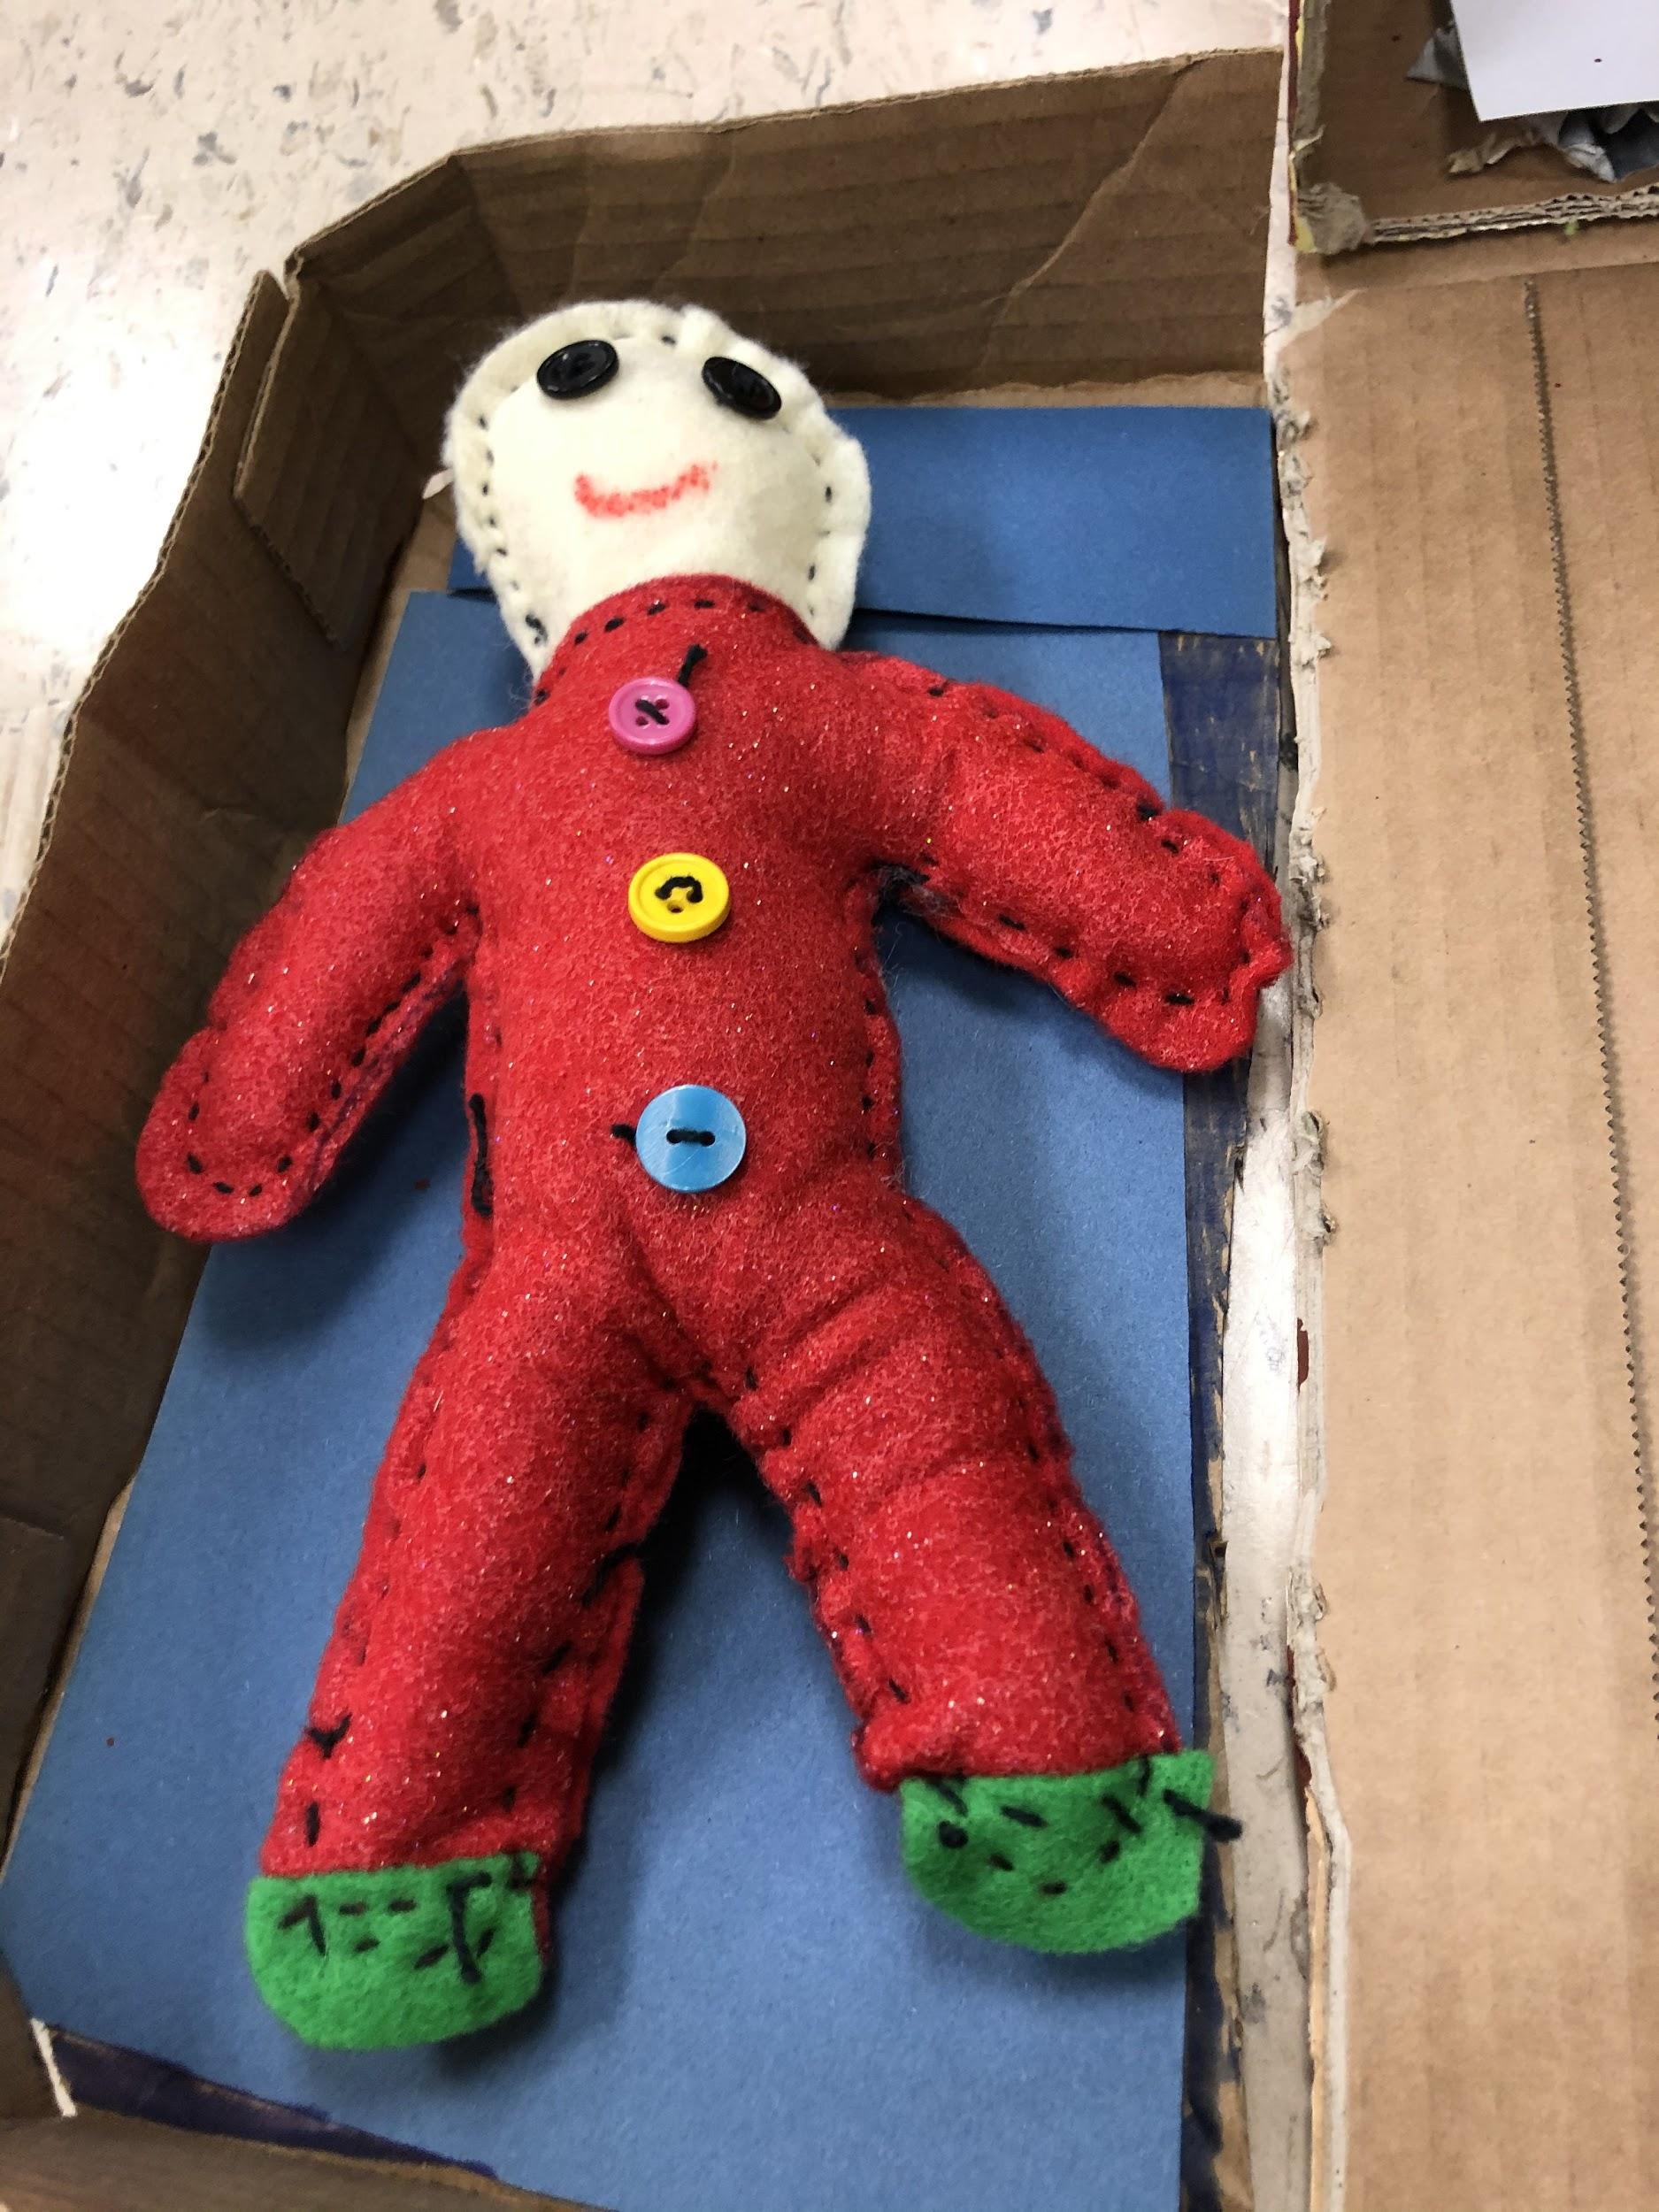
Dollhouse and Dolls

Slide 8
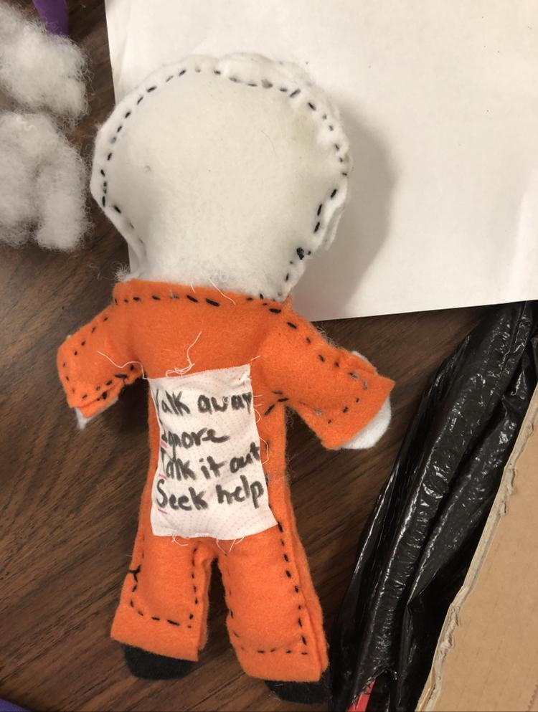
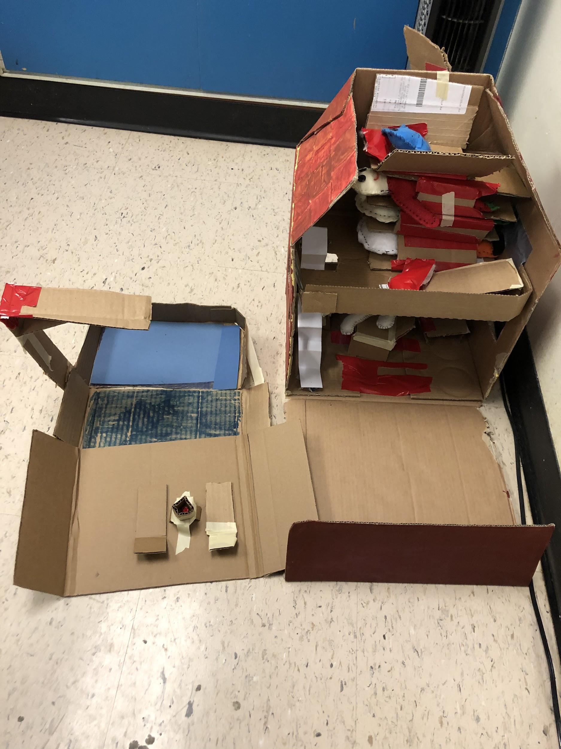
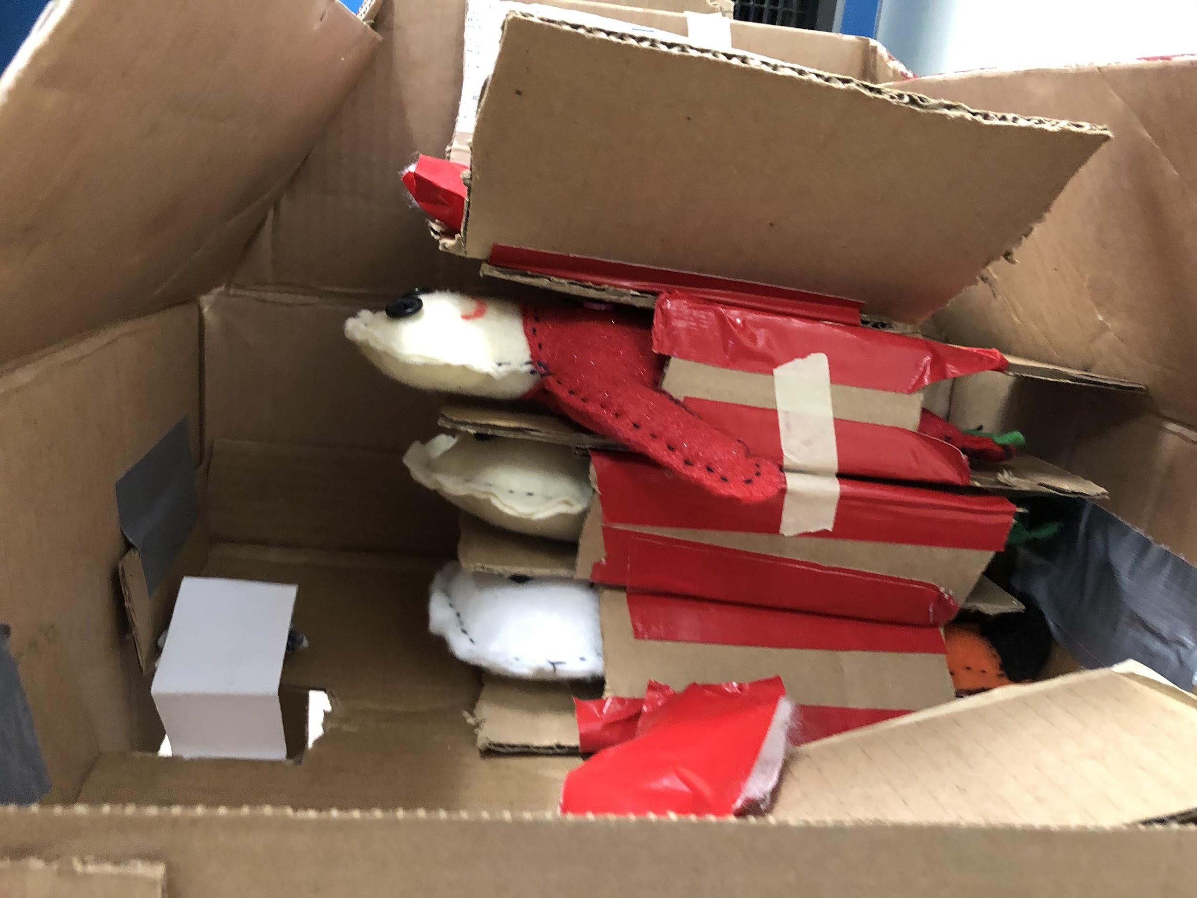
Dollhouse and Dolls

Slide 9
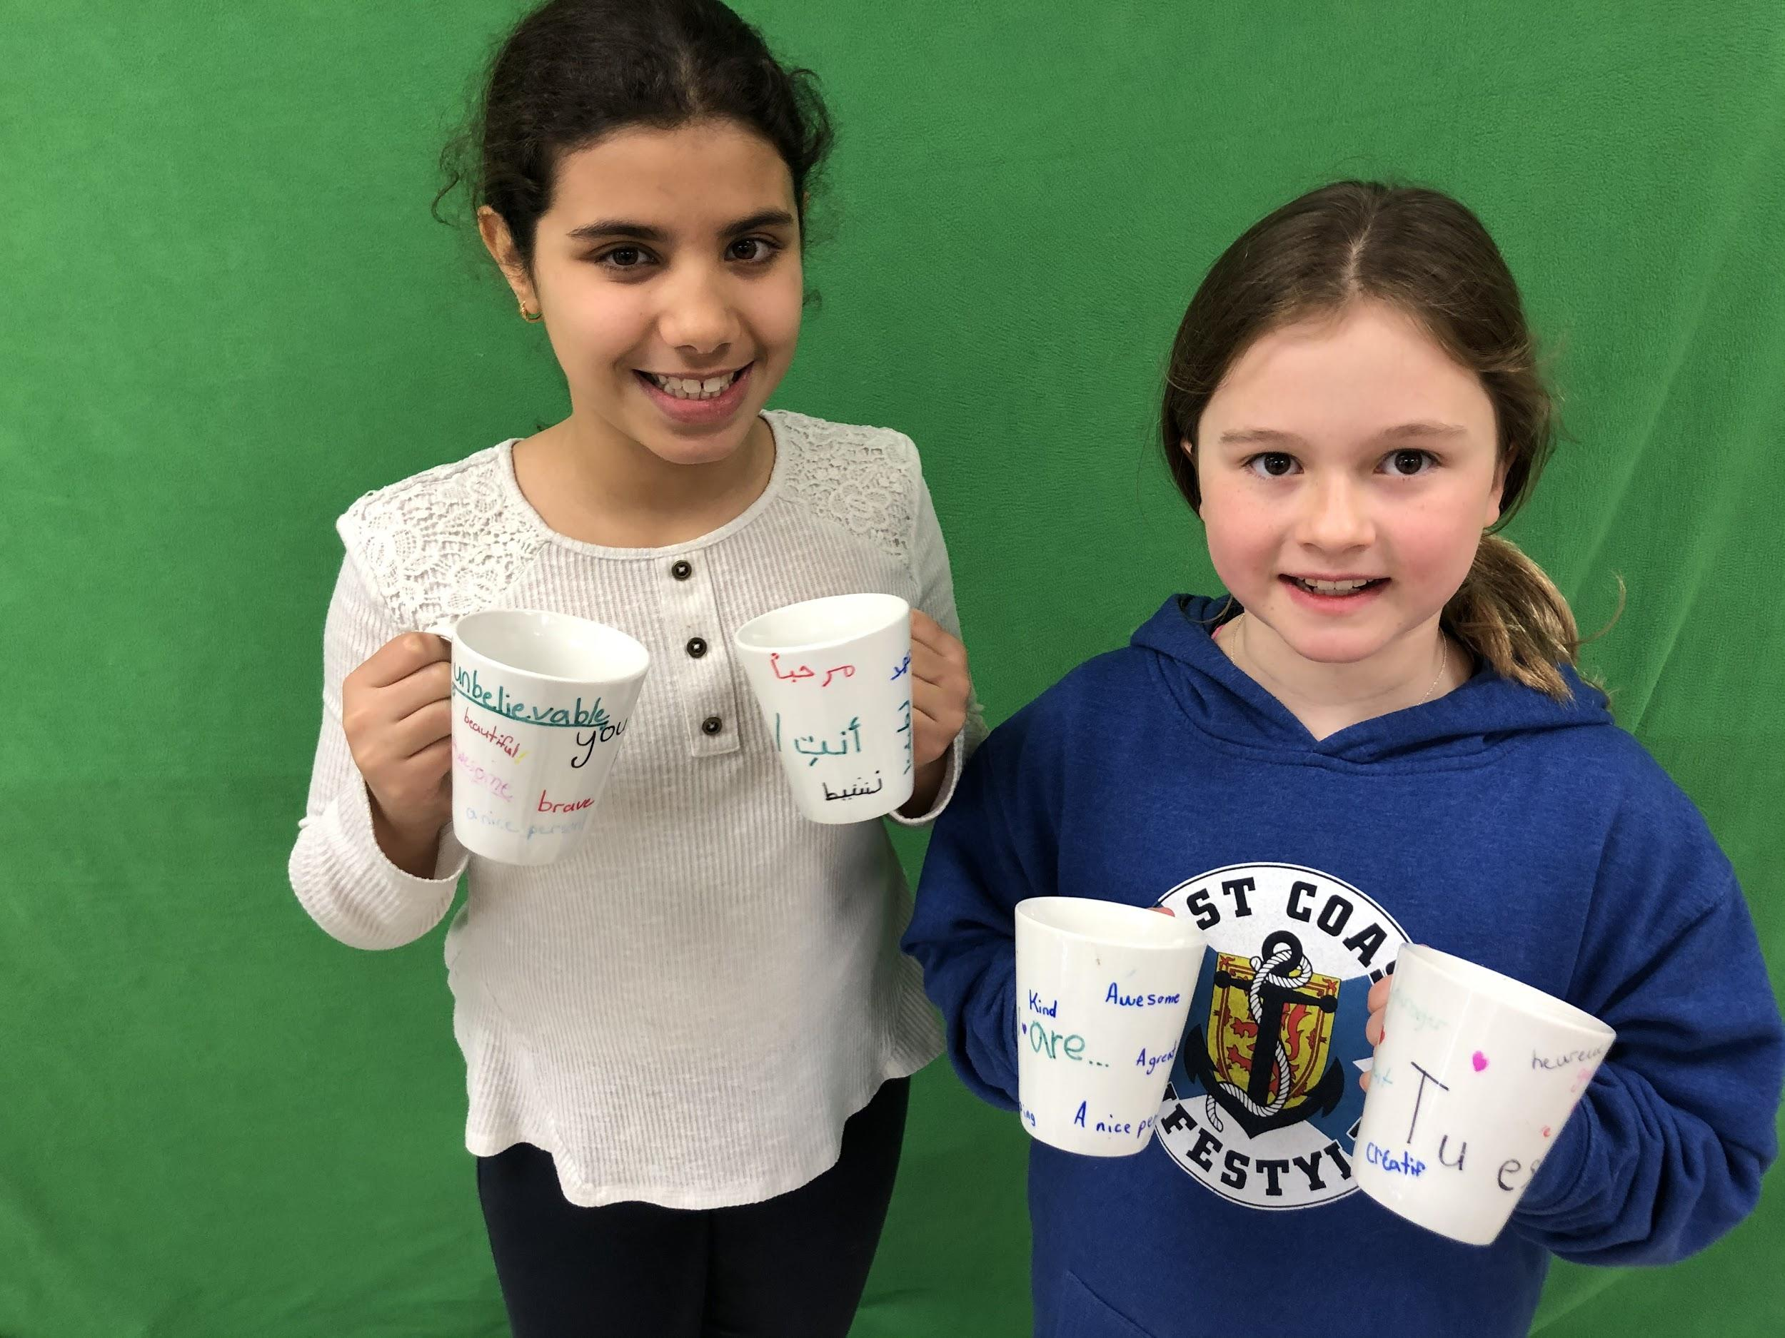
Inspirational Coffee Mugs
Goal: To help others have positive thoughts, in order to improve their self-confidence.
Product: A collection of mugs with inspirational messages, in three different languages. Students researched and discovered a way to create the mugs with messages that will not wash off.

Slide 10
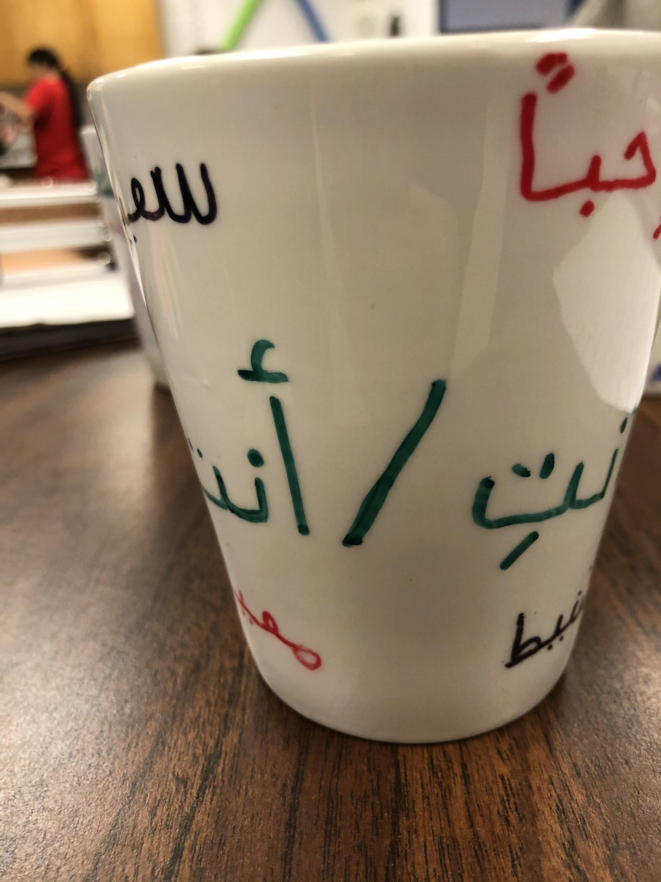
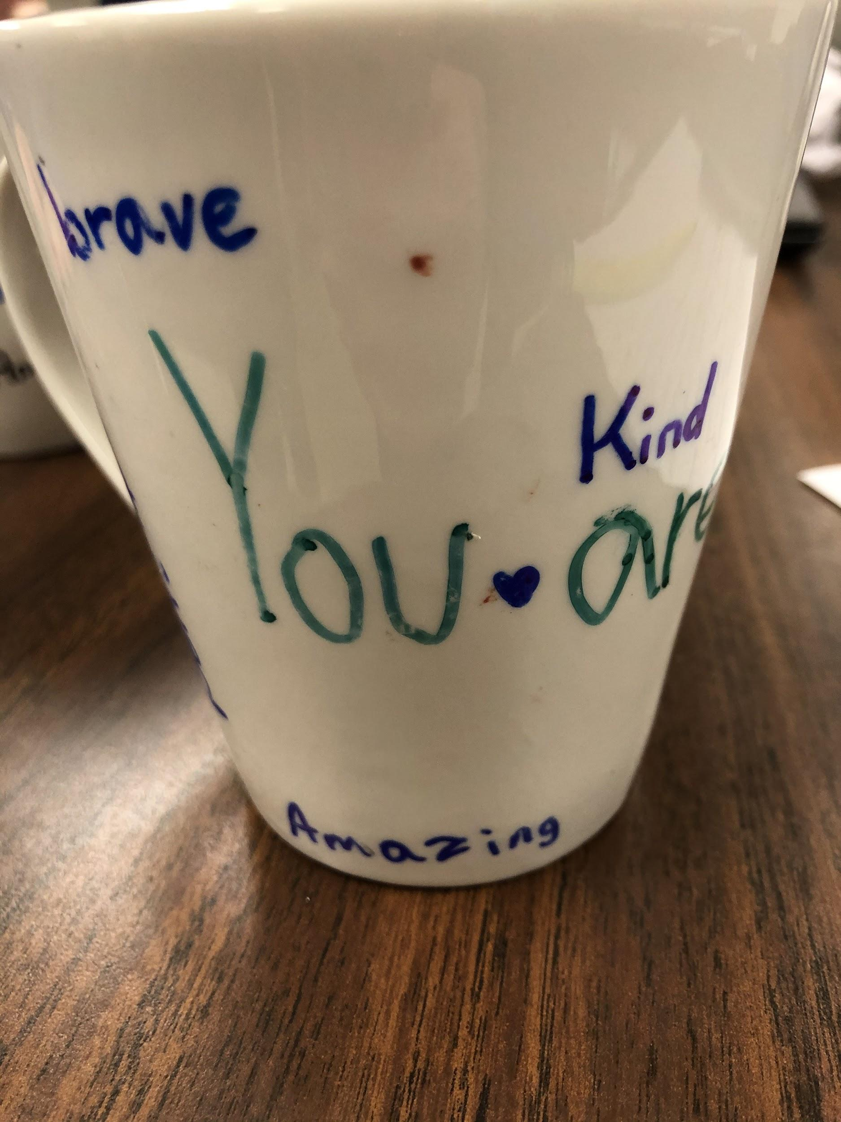
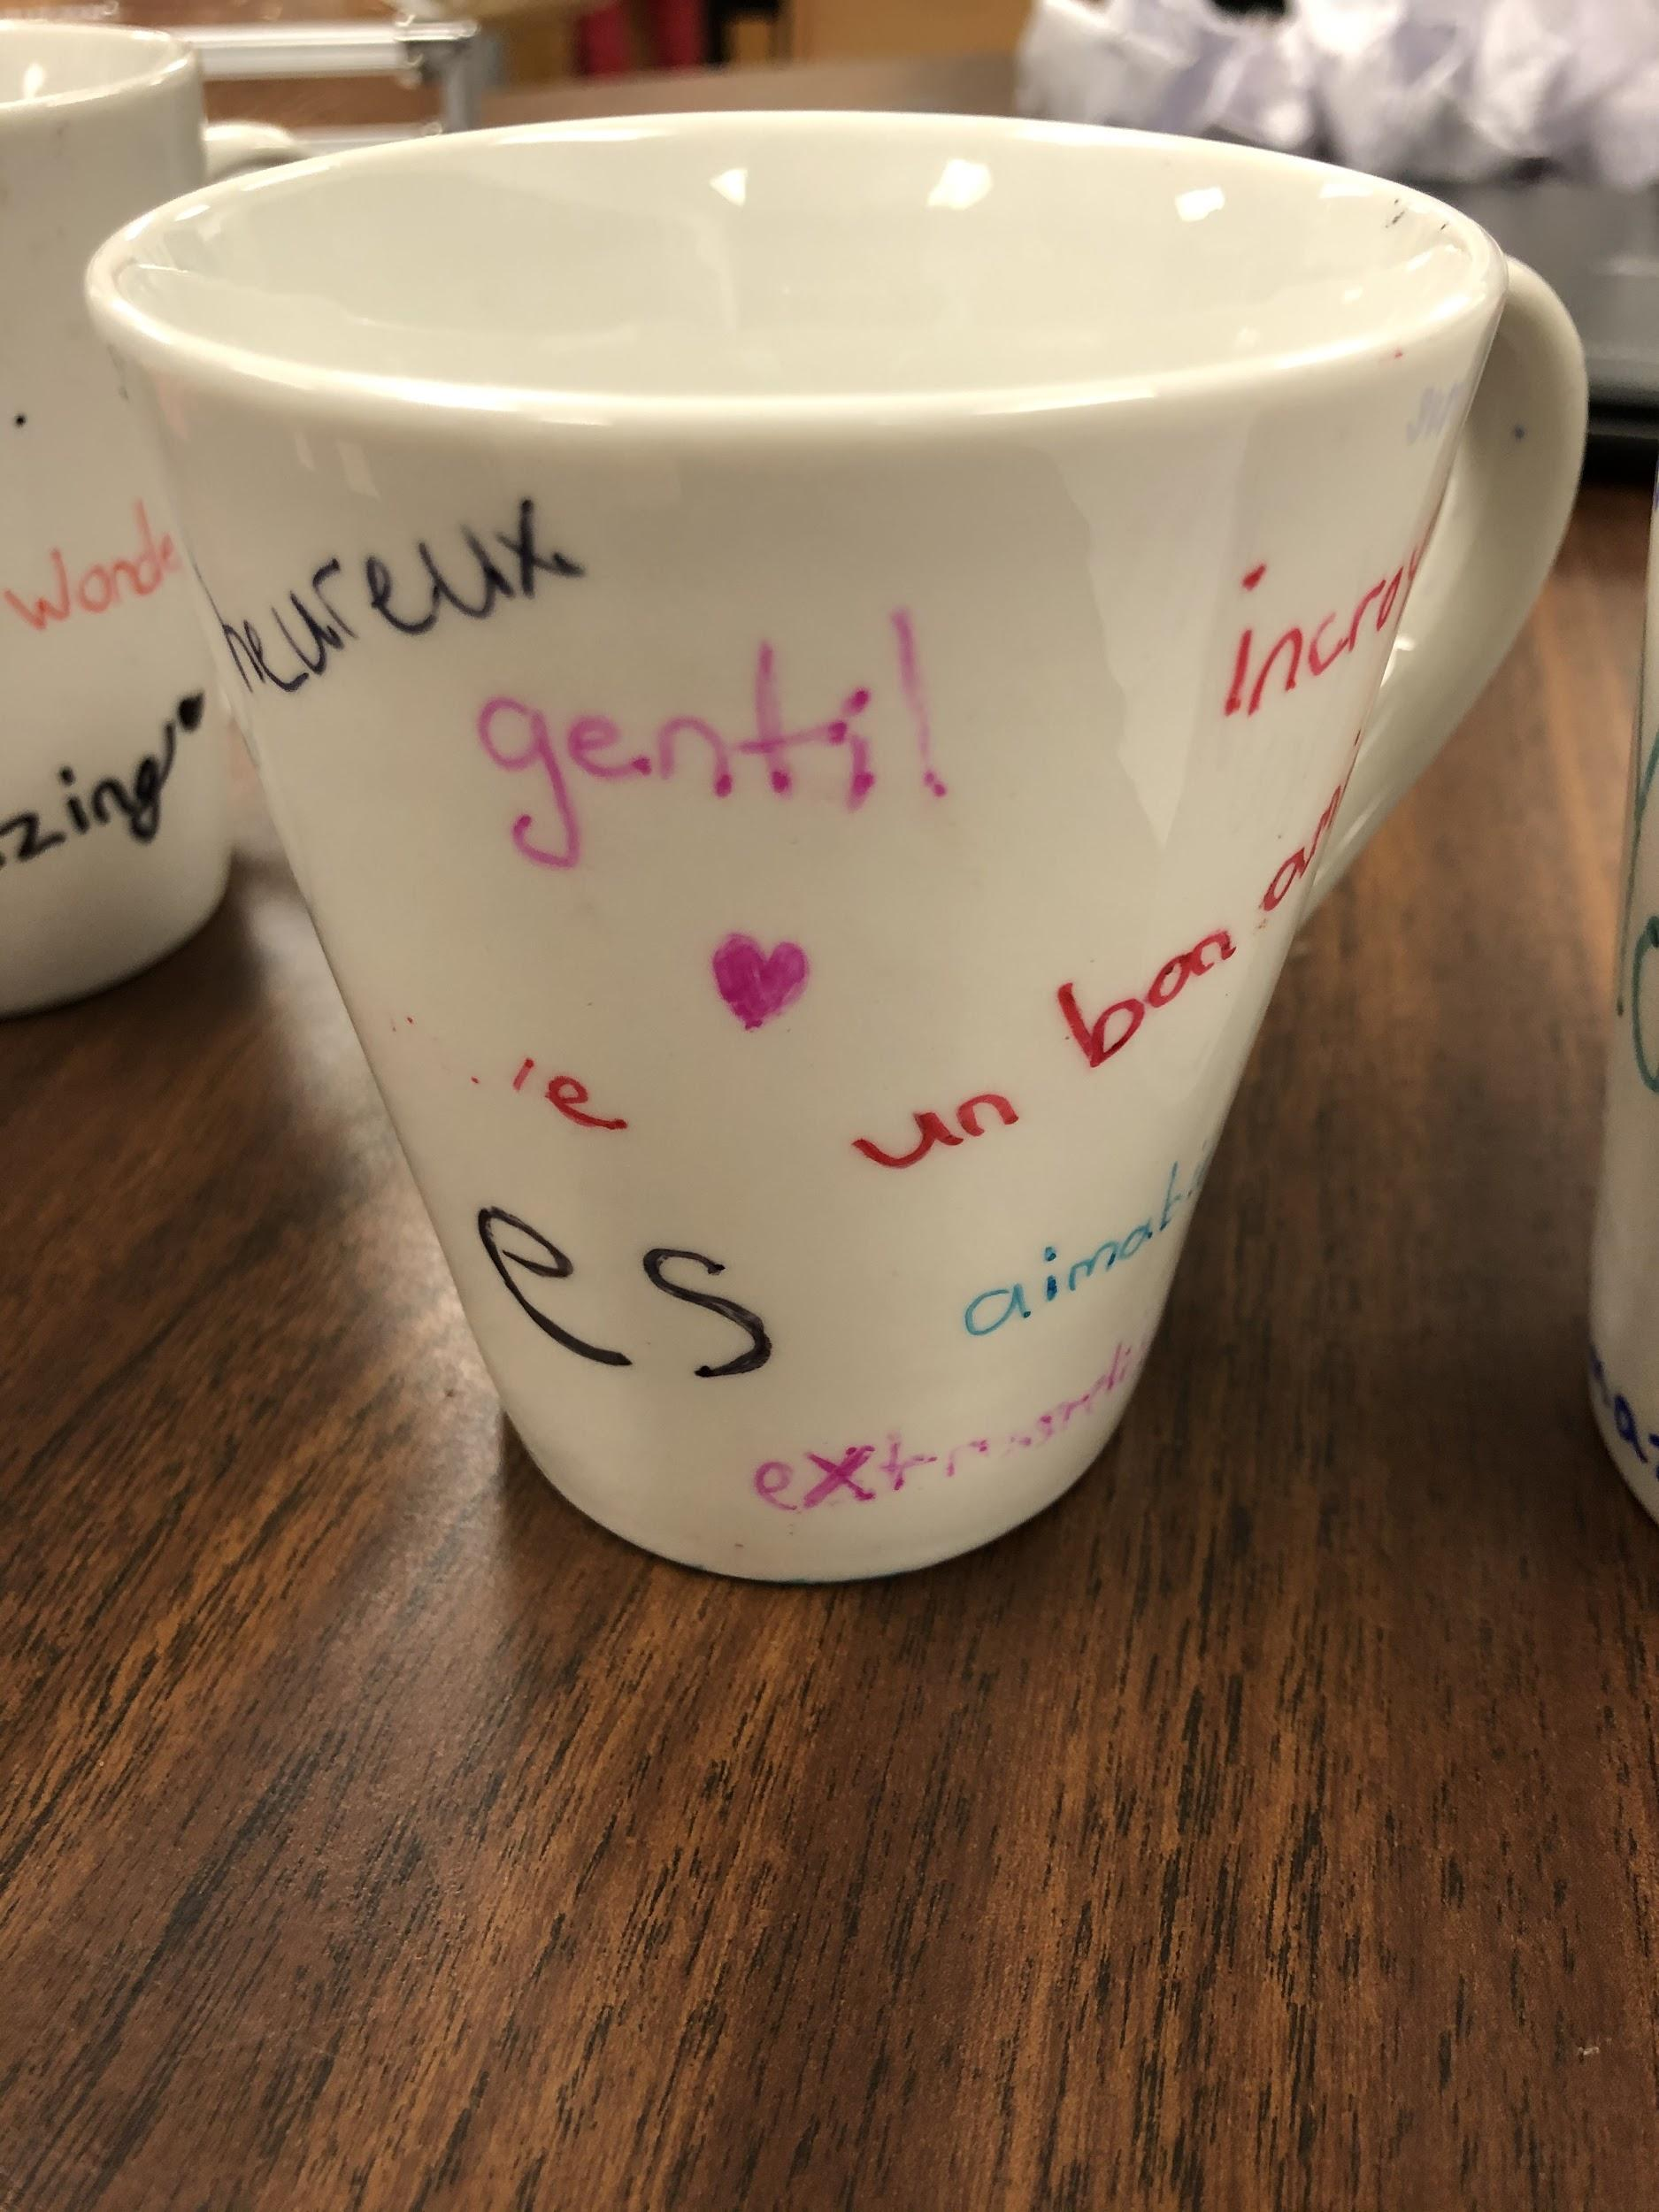
Inspirational Coffee Mugs

Slide 11
Inspirational Robot
Goal: To teach a relative going through treatment to feel calm.
Product: A robot-shaped statue with light-up eyes. On the front of the robot, there are instructions to help someone take a mindful moment. The eyes light up so that the user is able to complete the mindful moment in a dark room.

Slide 12
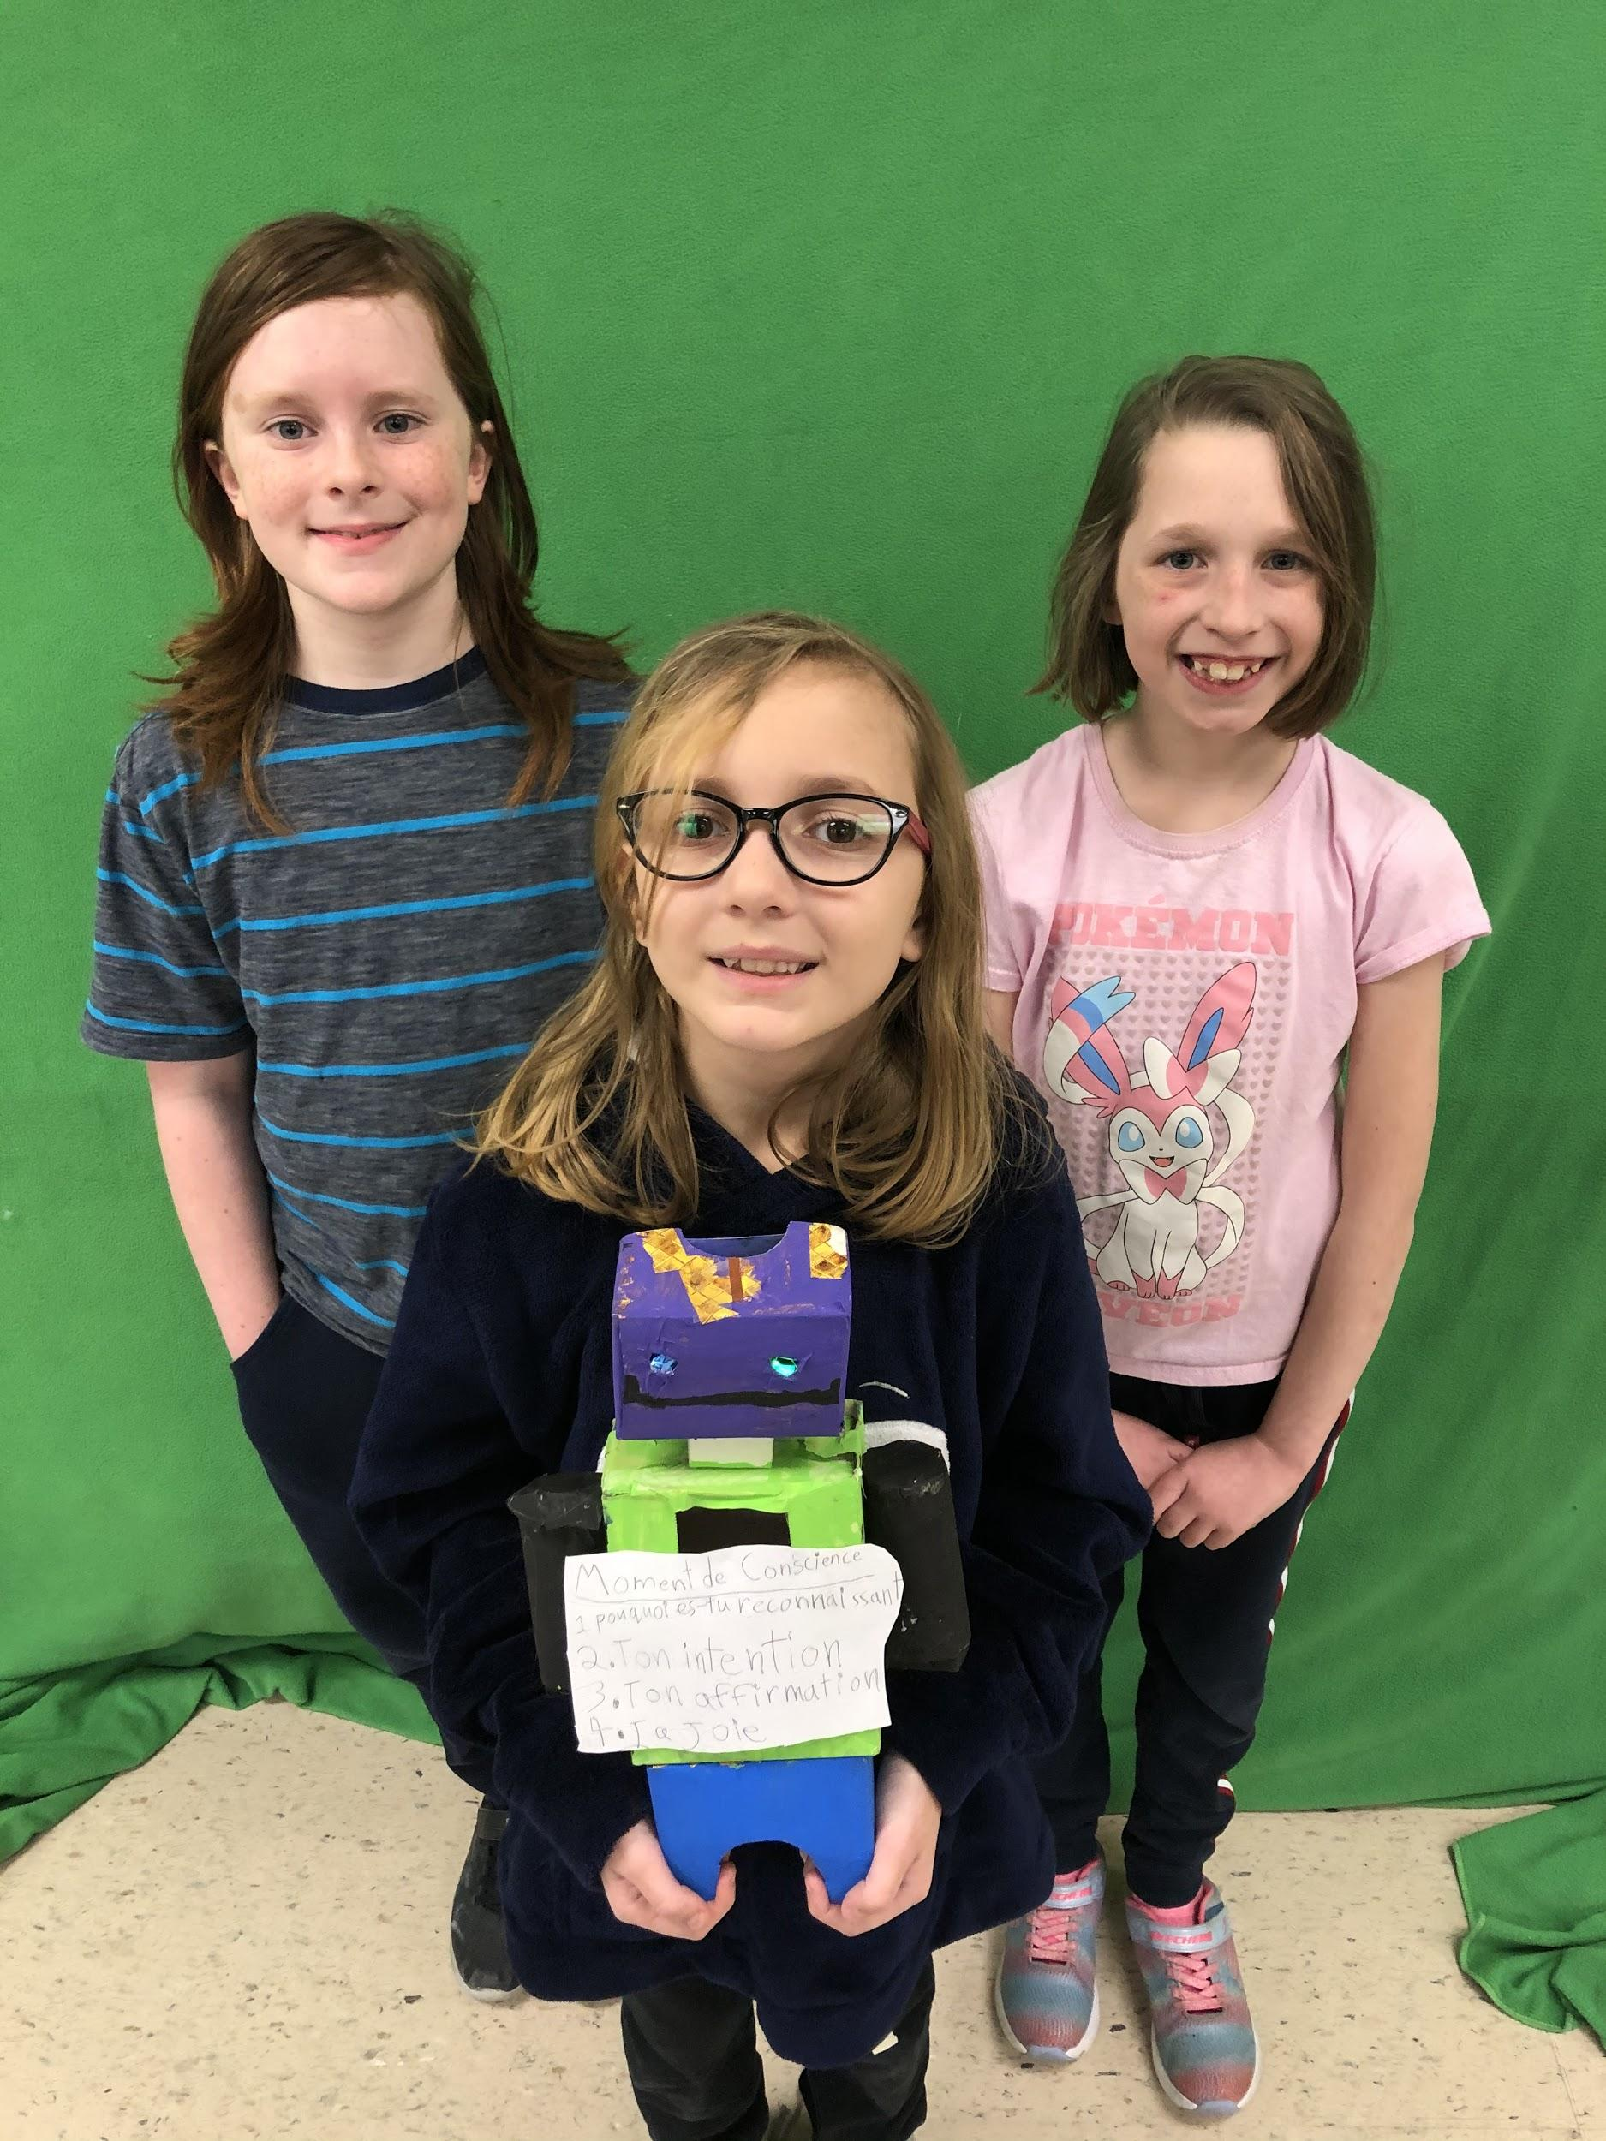
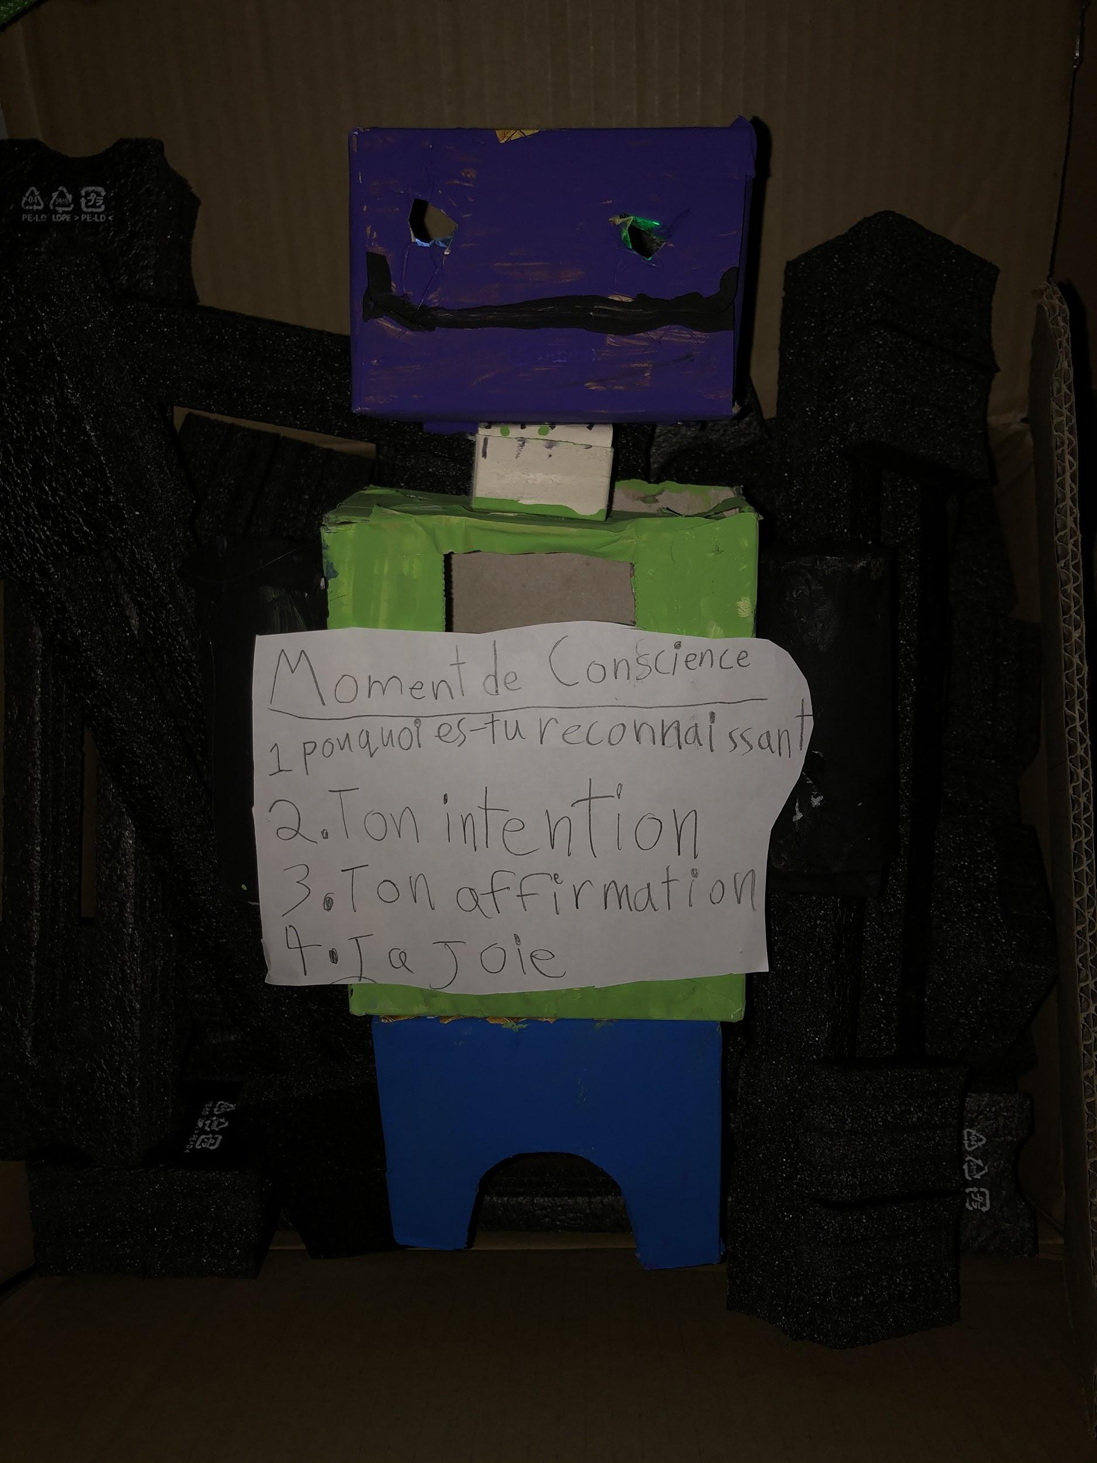
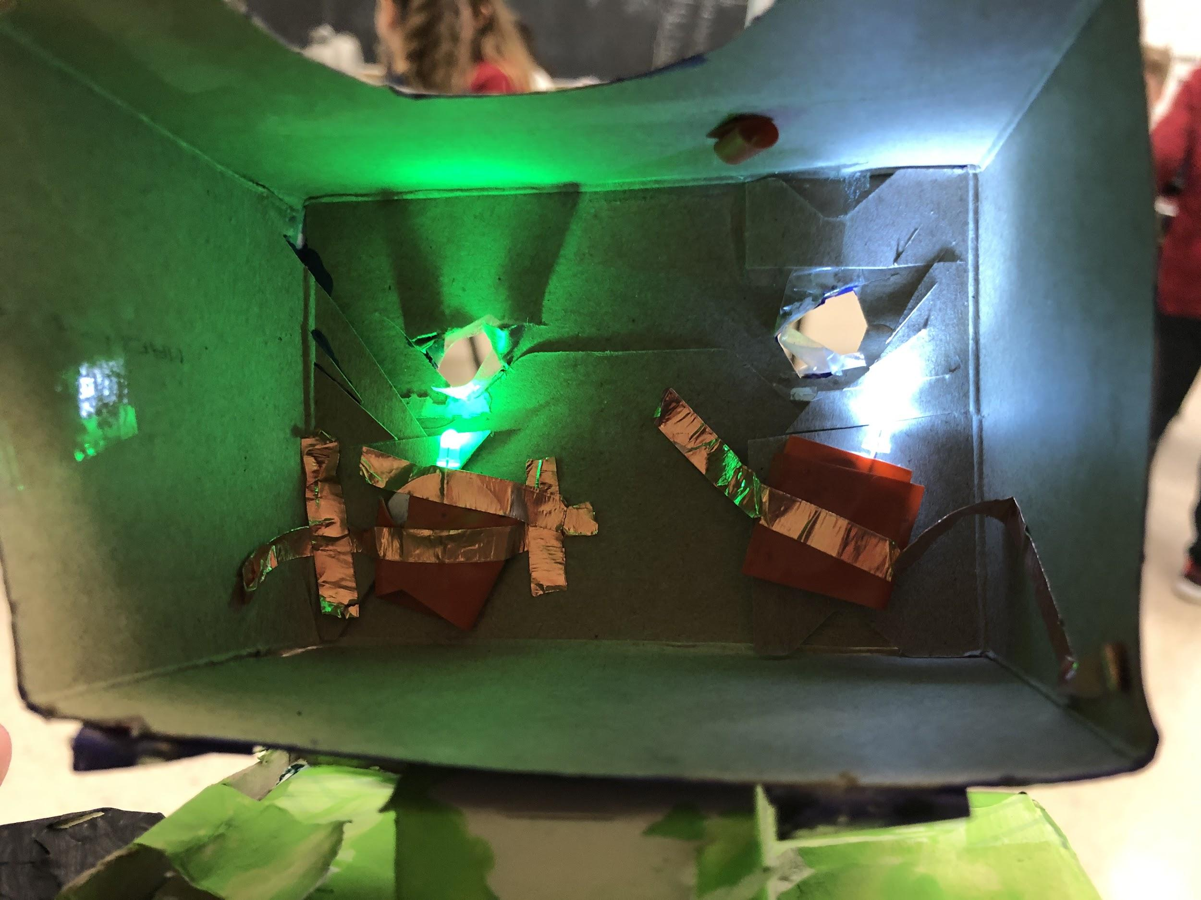
Inspirational Robot

Slide 13
Instructional Multilingual Video
Goal: To teach students who are new to the school (and might be nervous) how to take a mindful moment so that they can spend their day in the green zone.
Product: An instructional video using green screen and movie editing technology.
Link to Video

Slide 14
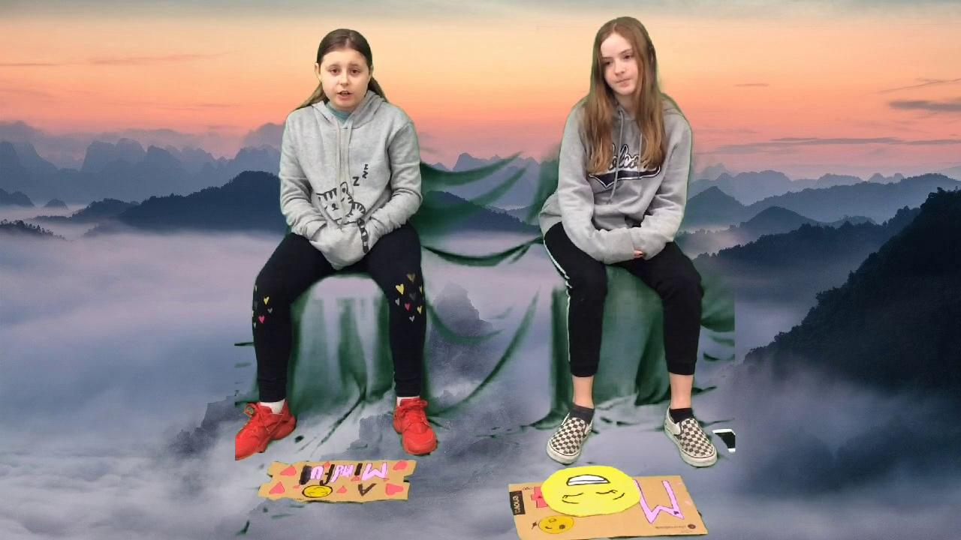
Instructional Video
Goal: To improve positive feelings and teach students who are experiencing the aftermath of the forest fires in Australia how to take a mindful moment.
Product: An instructional video using green screen and movie editing technology.
Link to Video

Slide 15
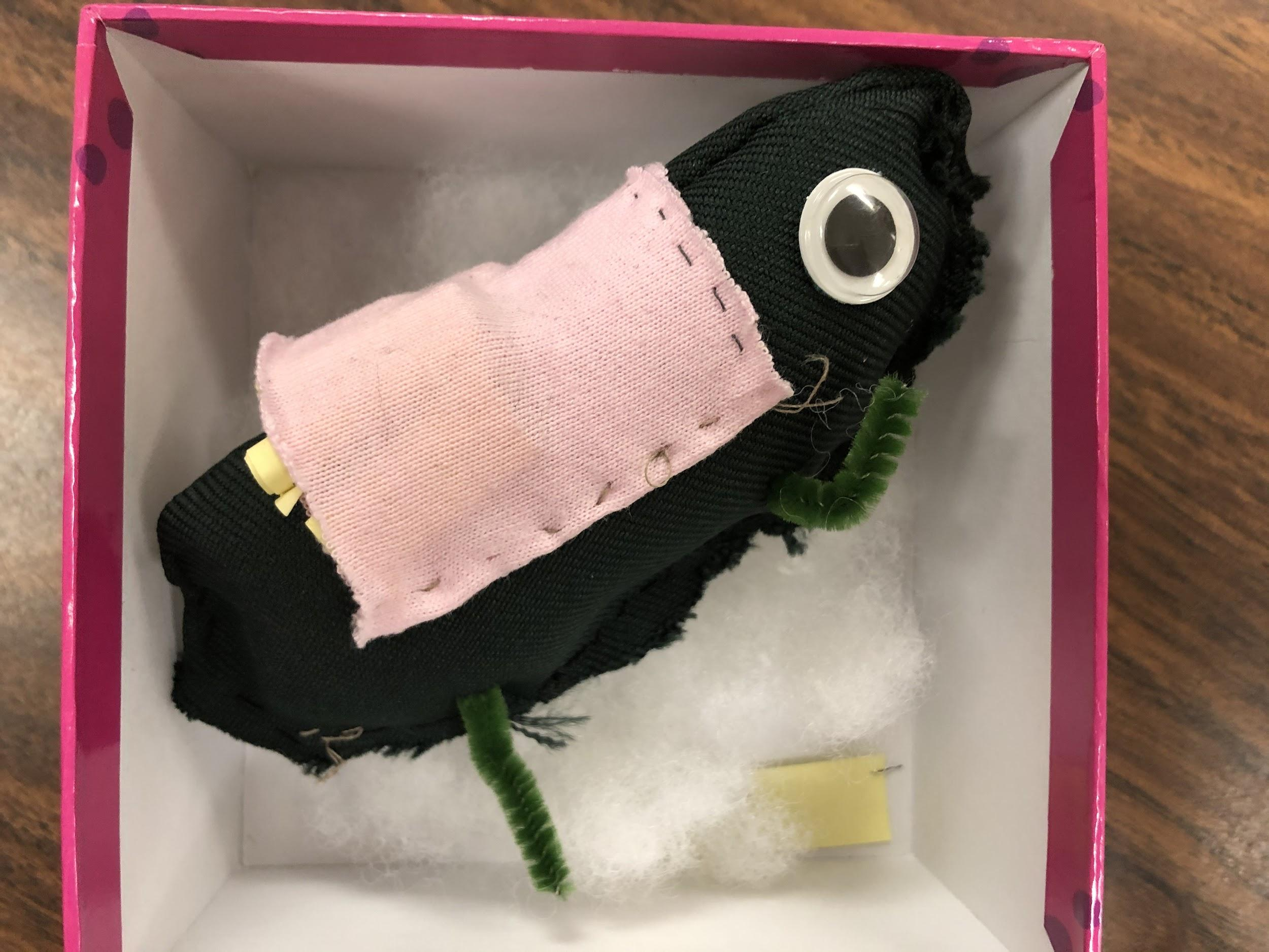
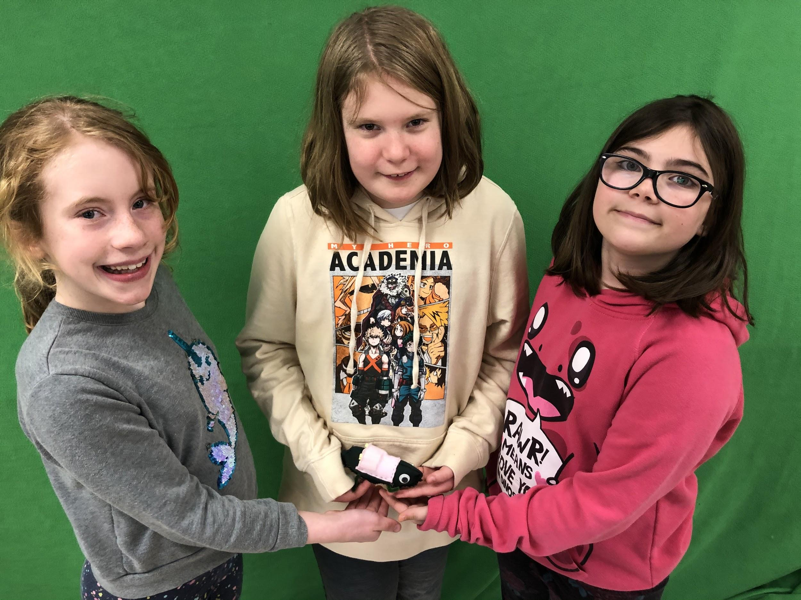
A Happiness Dinosaur
Goal: To improve the self-esteem of students who need to reset in the office.
Product: A hand-sewn stuffed dinosaur with a pocket containing bilingual inspirational messages. When students are in the office, they can take a message and improve their mood.

Slide 16
The Design Process
Students worked through the various stages of the design process, while communicating only in French, to accomplish their goals.
They have collaboratively created oral presentations (also in French) and will present their creations to the rest of the class.
Students are very proud of their accomplishments!

